Slide 1

Web-application for,
Village Vyapar
“Buy, Sell and Find just about Village Product (c2c)”

Slide 2
INDEX
No. | Content | Slide No.
1 | Group Information | 3
 | Company Profile | 4
3 | Project Definition | 5
4 | System Development Platform | 6
5 | Admin Panel | 7
6 | Customer Panel | 72
7 | Reports | 114
8 | References | 129

Slide 3
1 | Group Information | 3
 | Company Profile | 4
3 | Project Definition | 5
4 | System Development Platform | 6
5 | Admin Panel | 7
6 | Customer Panel | 72
7 | Reports | 114
8 | References | 129

Slide 4
Group Information :
GROUP NO : 04
Full Name | Enrollment No
Raja Himani Yatin | 205160694004
Chauhan Zeel Jitendrakumar | 205160694009
Parmar Devansh Rajeshbhai | 205160694023
Lashkari Parth Ashokbhai | 205160694029
Internal Faculty : :
Prof. Alka Patel

Slide 5
1
INTRODUCTION

Slide 6

Existing System :
Existing system is trading between people through calls,
and middle man therefore it is limited geographically.

Slide 7


Need for the New System :
The geographical limitation stops the business from growing and hence a lot of products do not get much attention.
It is difficult to account for the sales.
Cost of product is increased as middle man is included also
there is thin profit margin

Slide 8
Objective of New System :
This system allows to directly communicate via chat board so customer and
seller can negotiate on suitable price.
To increase the sales of the current small scale village businesses.
To provide multiple source of the same products which ensures that the
customer gets the desired quality product.
Cost of product is reduced as middle man is eliminated.
Customer can view products in any native language.

Slide 9
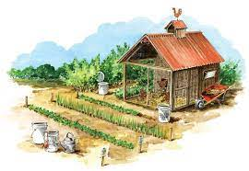
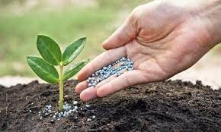
Project Definition :
This project is aimed at developing a web application that depicts online shopping of village products such as
food, Animals feed, Handicraft etc.
This web application also allows customer to
sell the product and others can purchase or vice versa
(i.e. Customer to Customer).
It provides a communication medium via chat board.

Slide 10




Core Components :
Admin
Customer
Visitor

Slide 11
Admin
Login
Manage Profile
Manage Customers
Manage Category & Sub category
Manage Products
Manage Inquiry
Manage Feedback
Generate Reports

Slide 12
Customer
Login
Manage Profile
Search Rural Product
View Categories & Sub Categories
View Rural Product in multiple language
Chat with Seller/Buyer
Inquiry
Feedback
Manage Inquiry
Manage Product
Manage Wishlist

Slide 13
Visitor
Registration
Search Rural Product
View Rural Product
View Feedback & Rating

Slide 14
Project Profile :

Slide 15
Assumptions & Constraint :

Slide 16
Advantages of Proposed System :

Slide 17
Disadvantage of Proposed System :

Slide 18
2
Requirement Determination & Analysis

Slide 19

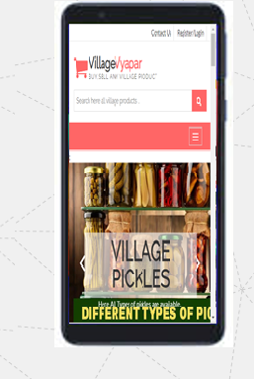
Requirement Determination

Slide 20
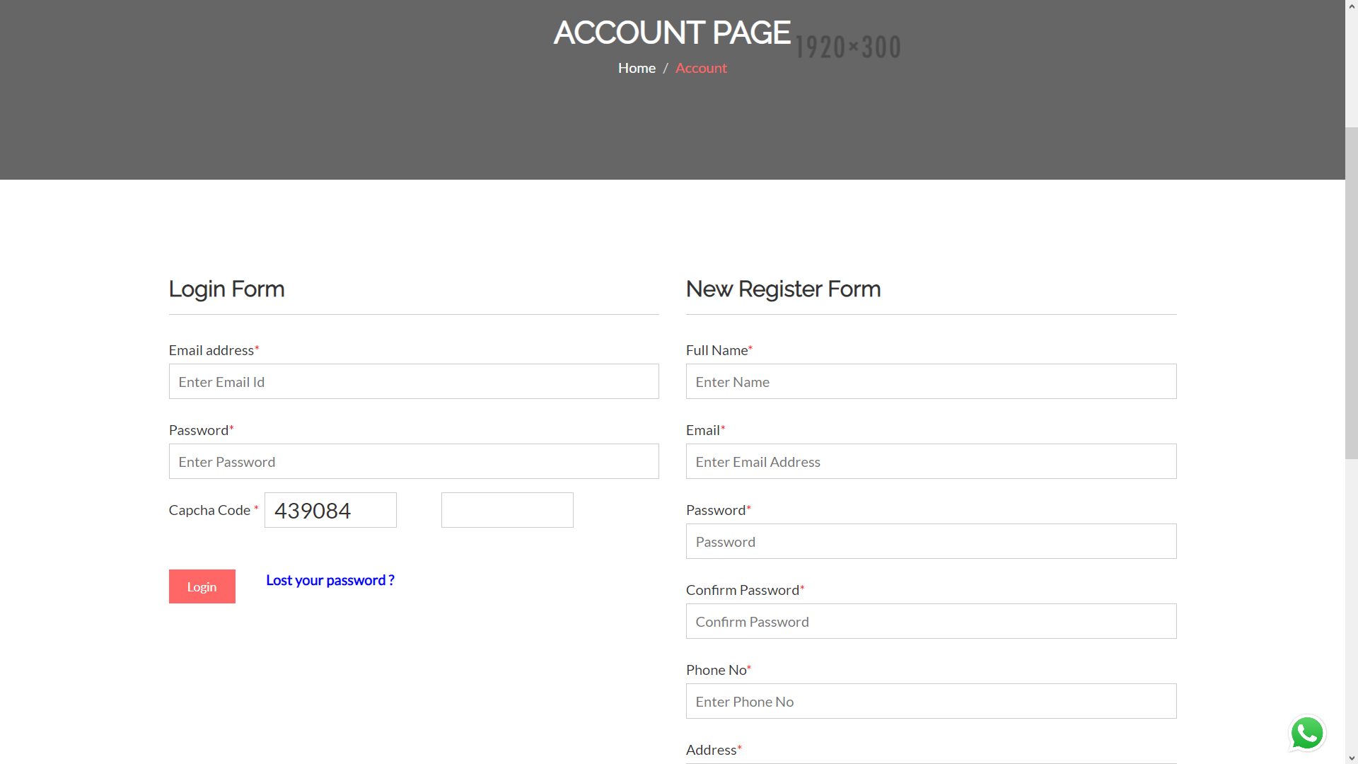
Login and Registration page

Slide 21
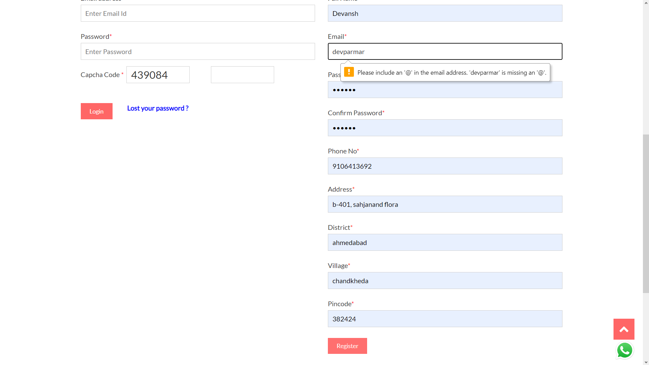
Registration with invalid credentials

Slide 22
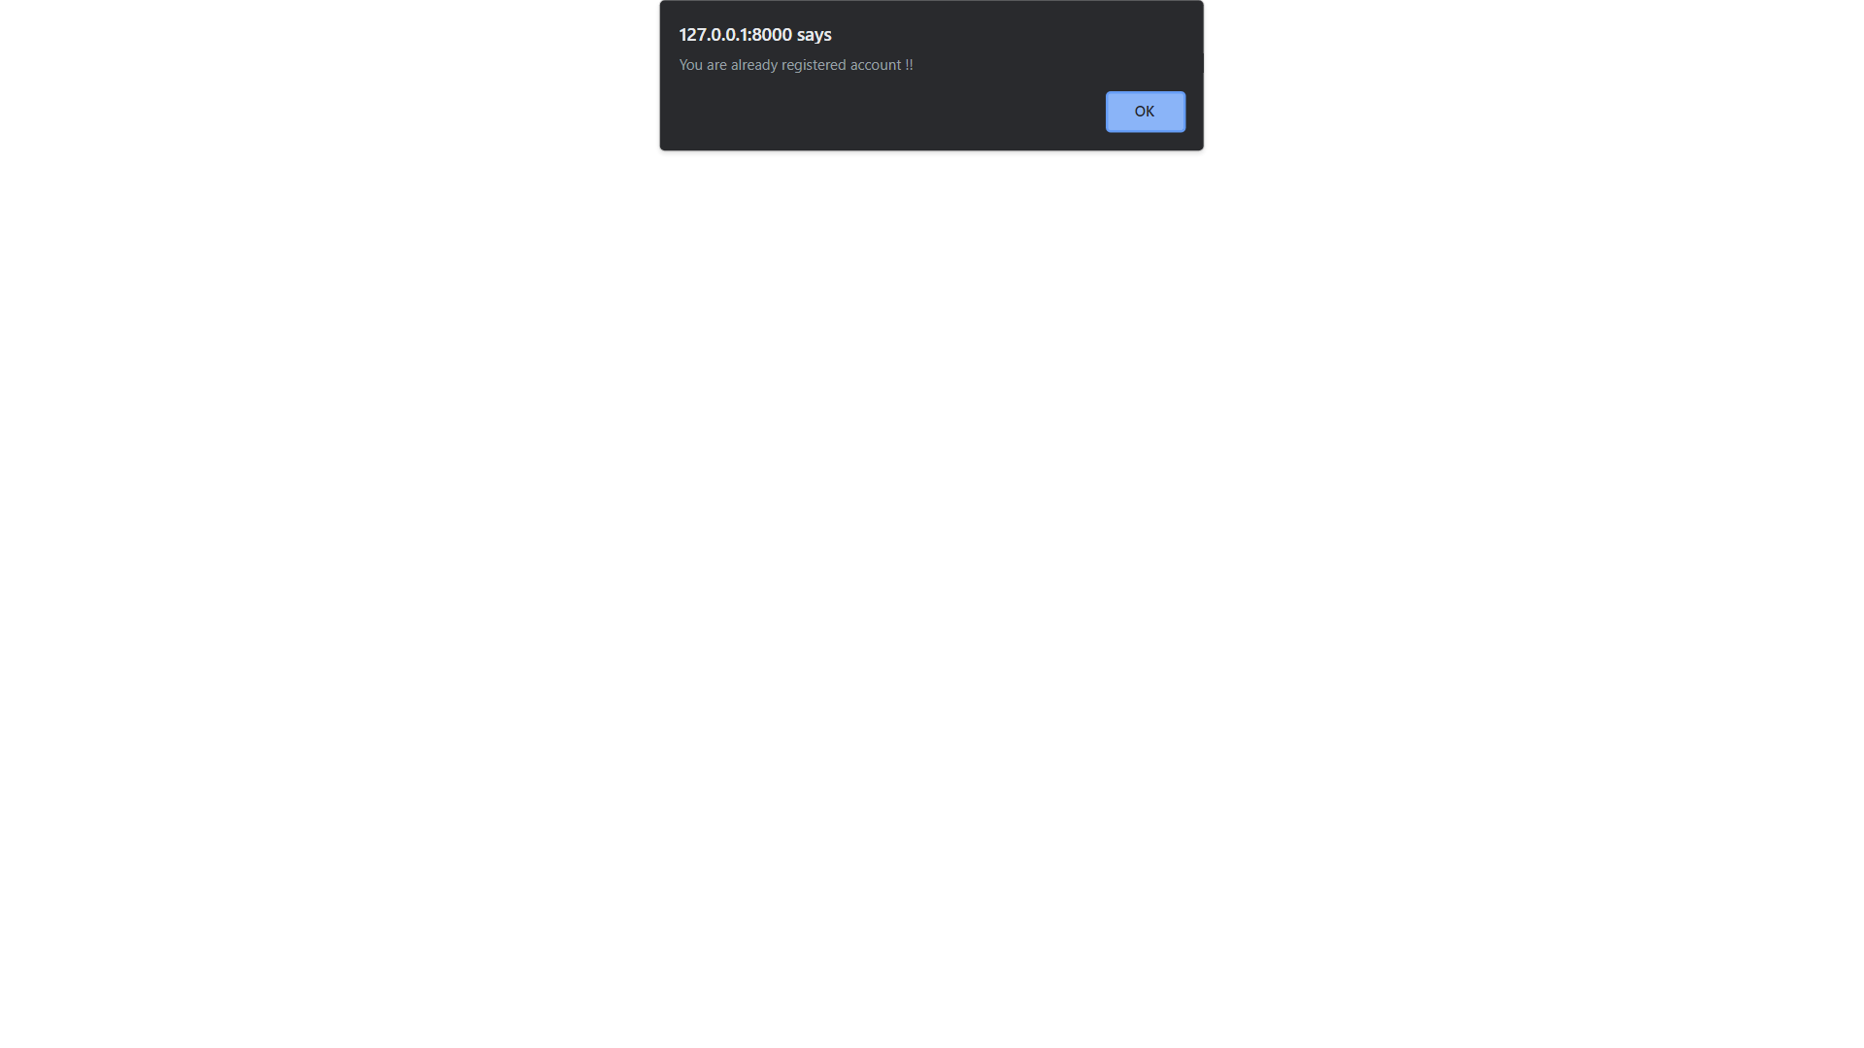
Registration with existing email

Slide 23

OTP sent at email on New Registration

Slide 24
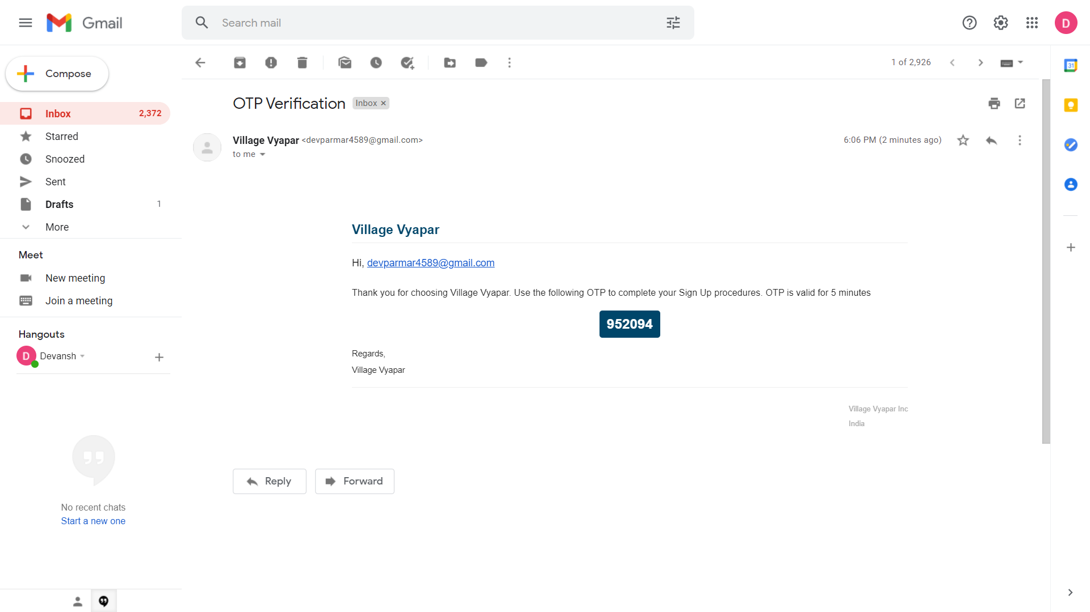
OTP sent at email on New Registration

Slide 25
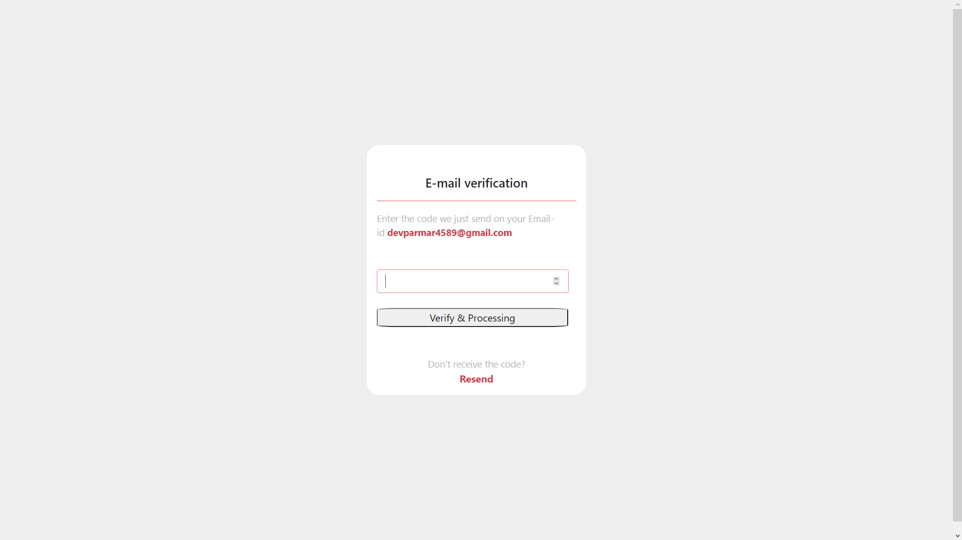
Confirm OTP sent at email

Slide 26

Homepage after Registration and login

Slide 27

Login with invalid credentials

Slide 28
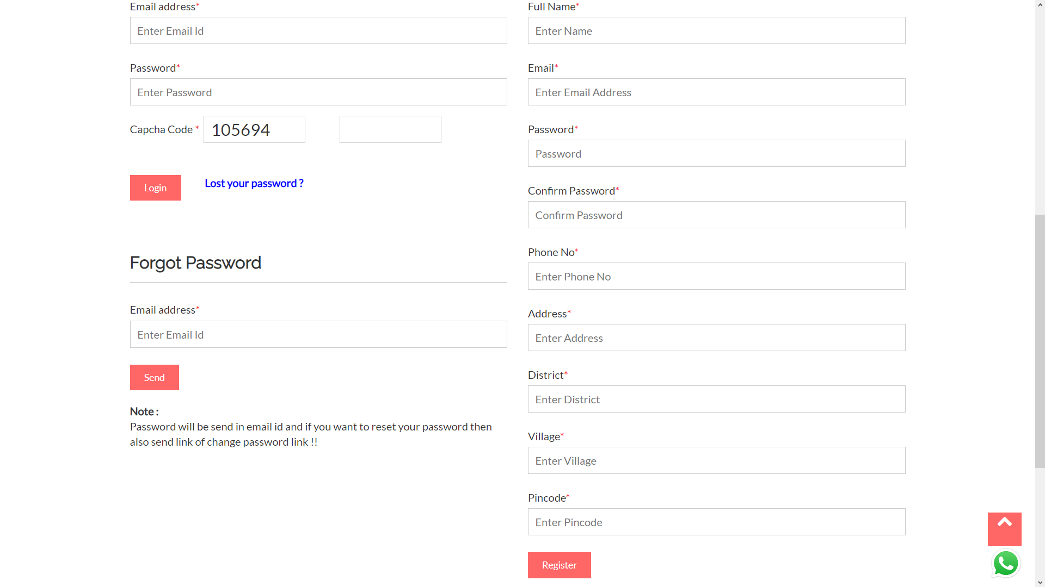
Forgot password

Slide 29

Lost password sent at email address

Slide 30
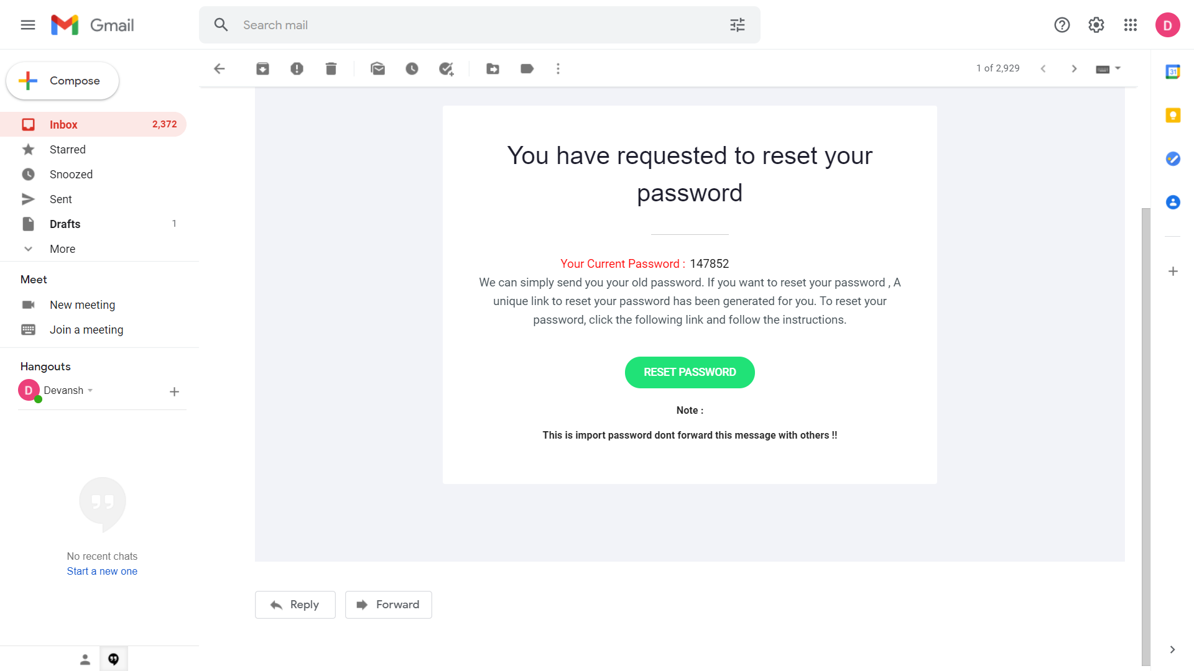
Email sent for lost password

Slide 31

Welcome page after login

Slide 32

Welcome page

Slide 33
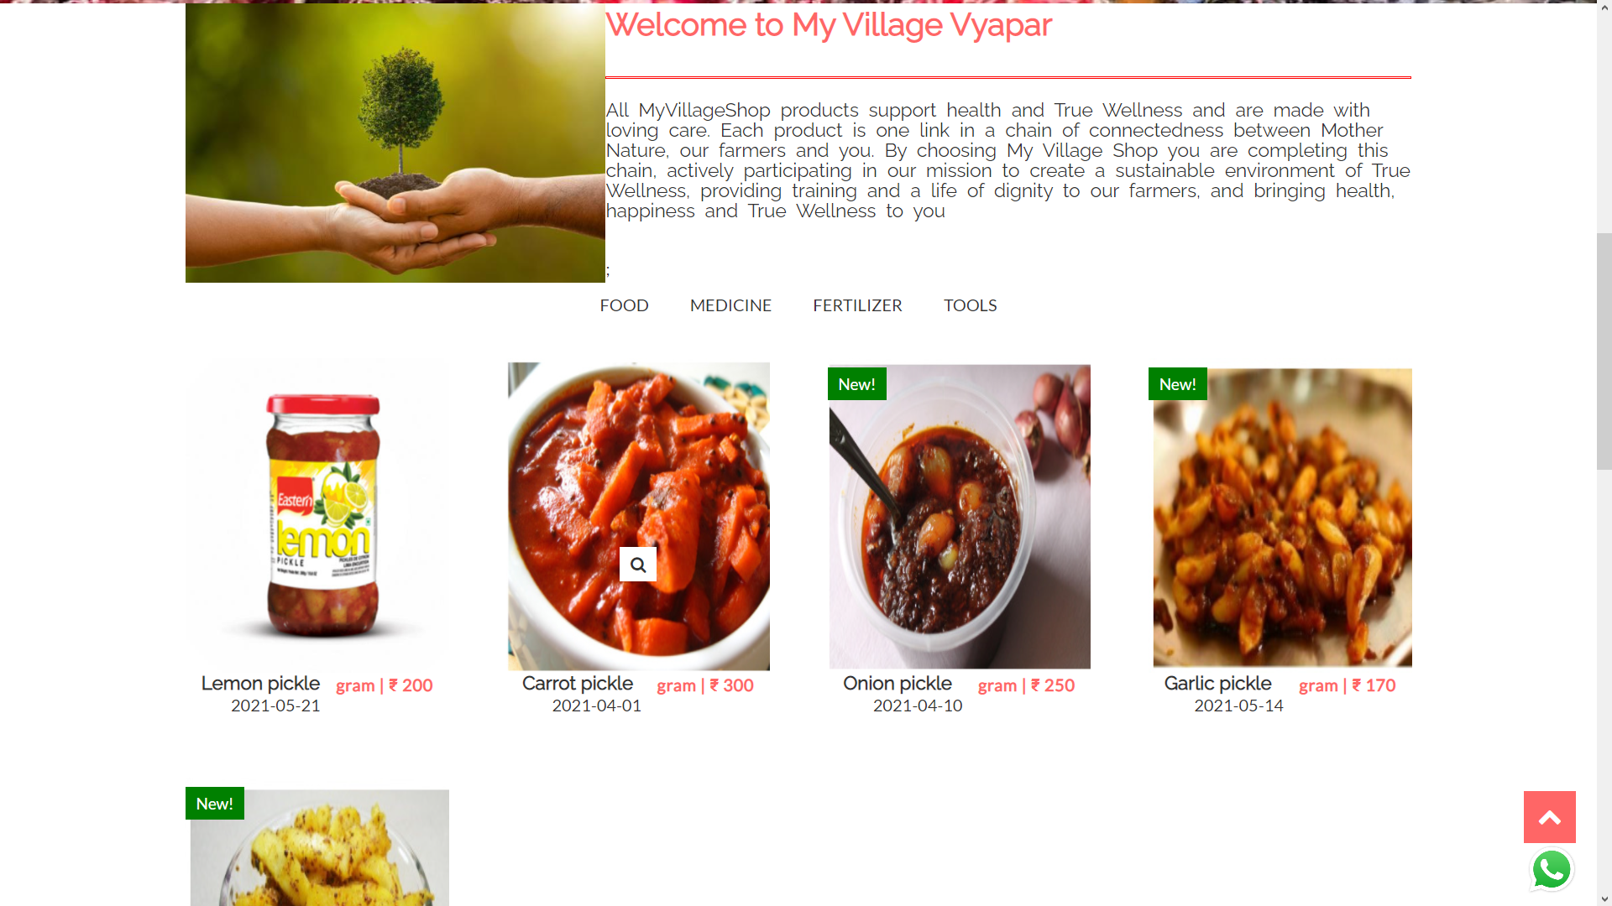
Welcome page

Slide 34
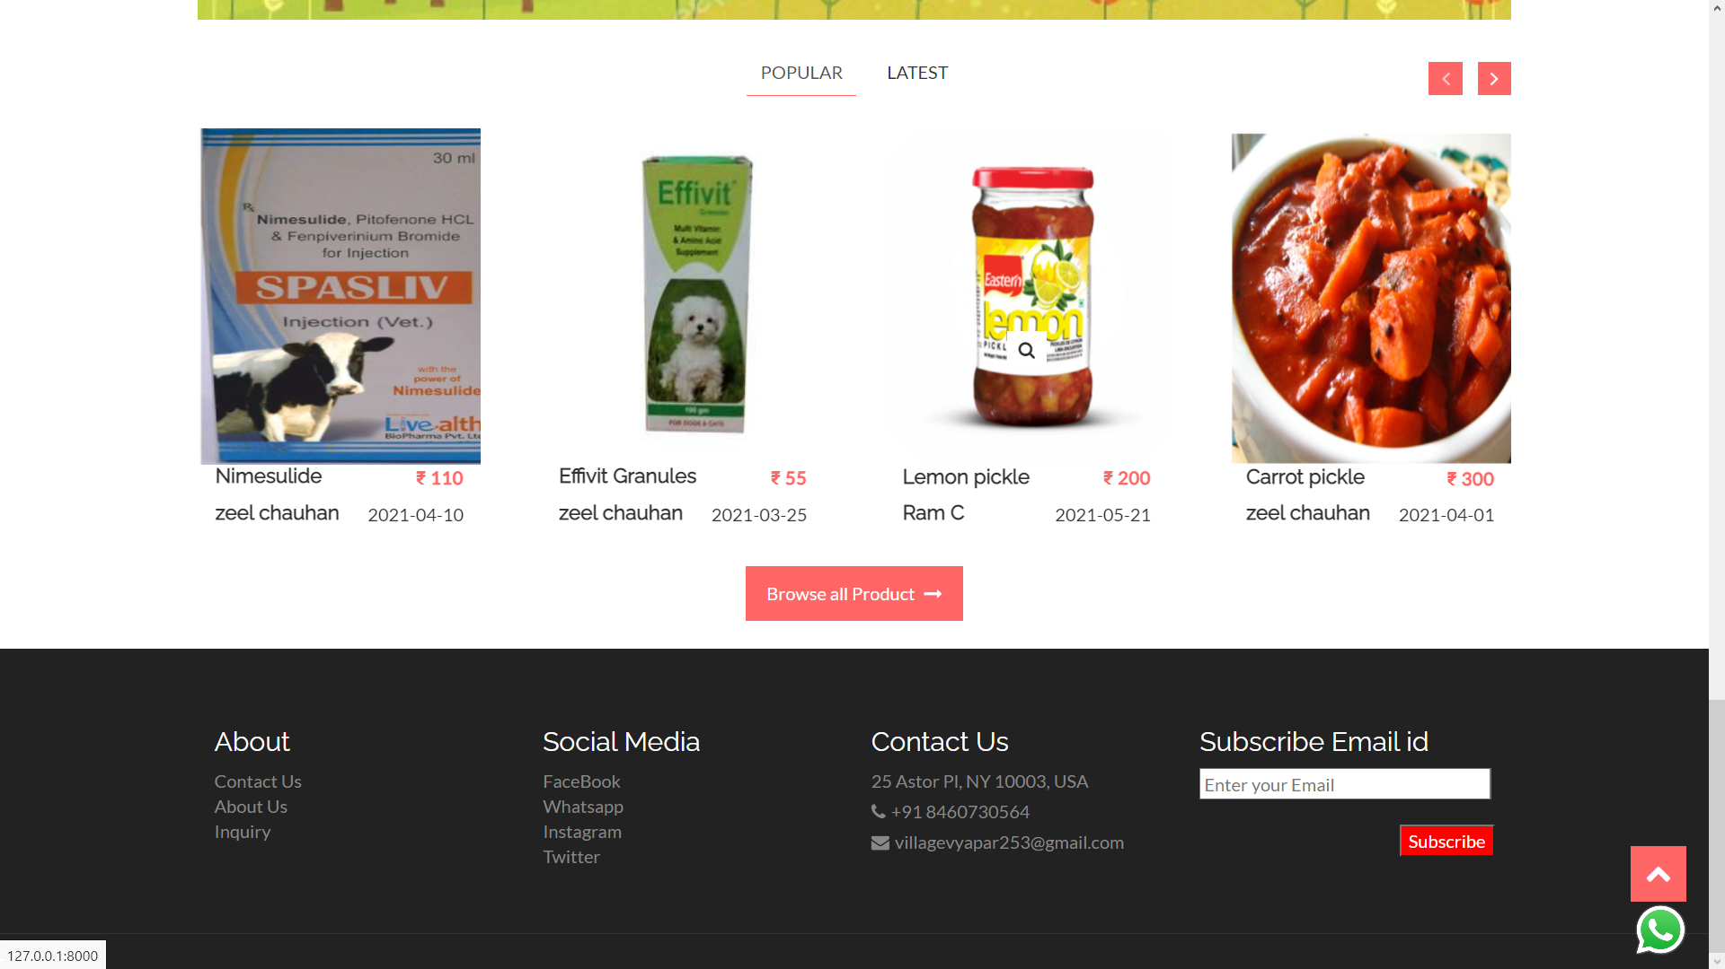
Welcome page Popular products

Slide 35
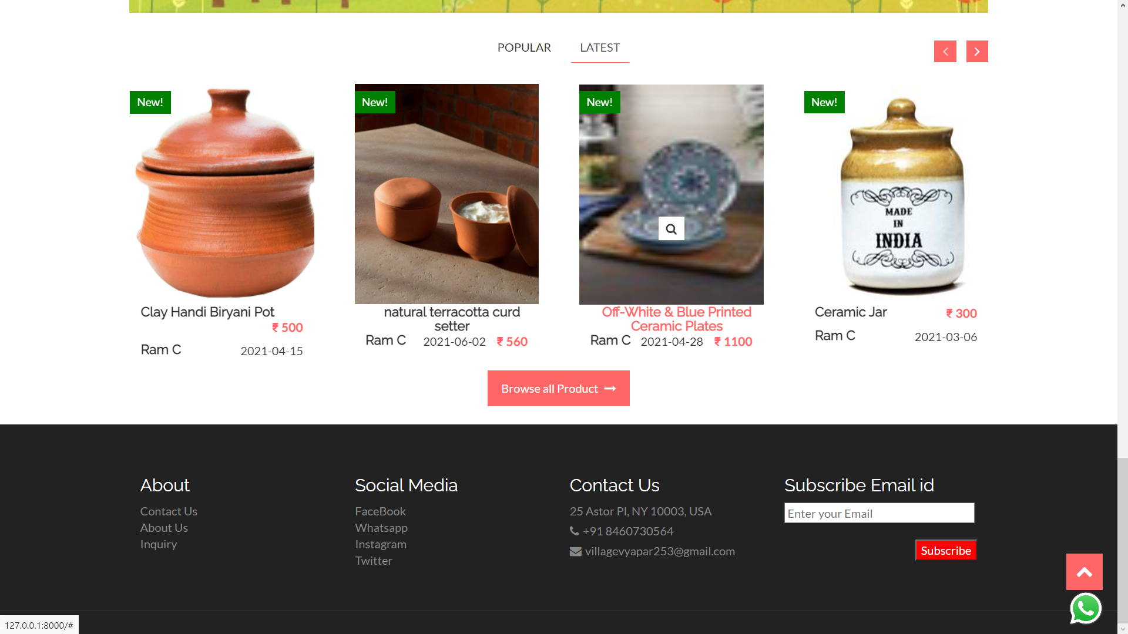
Welcome page Latest products

Slide 36
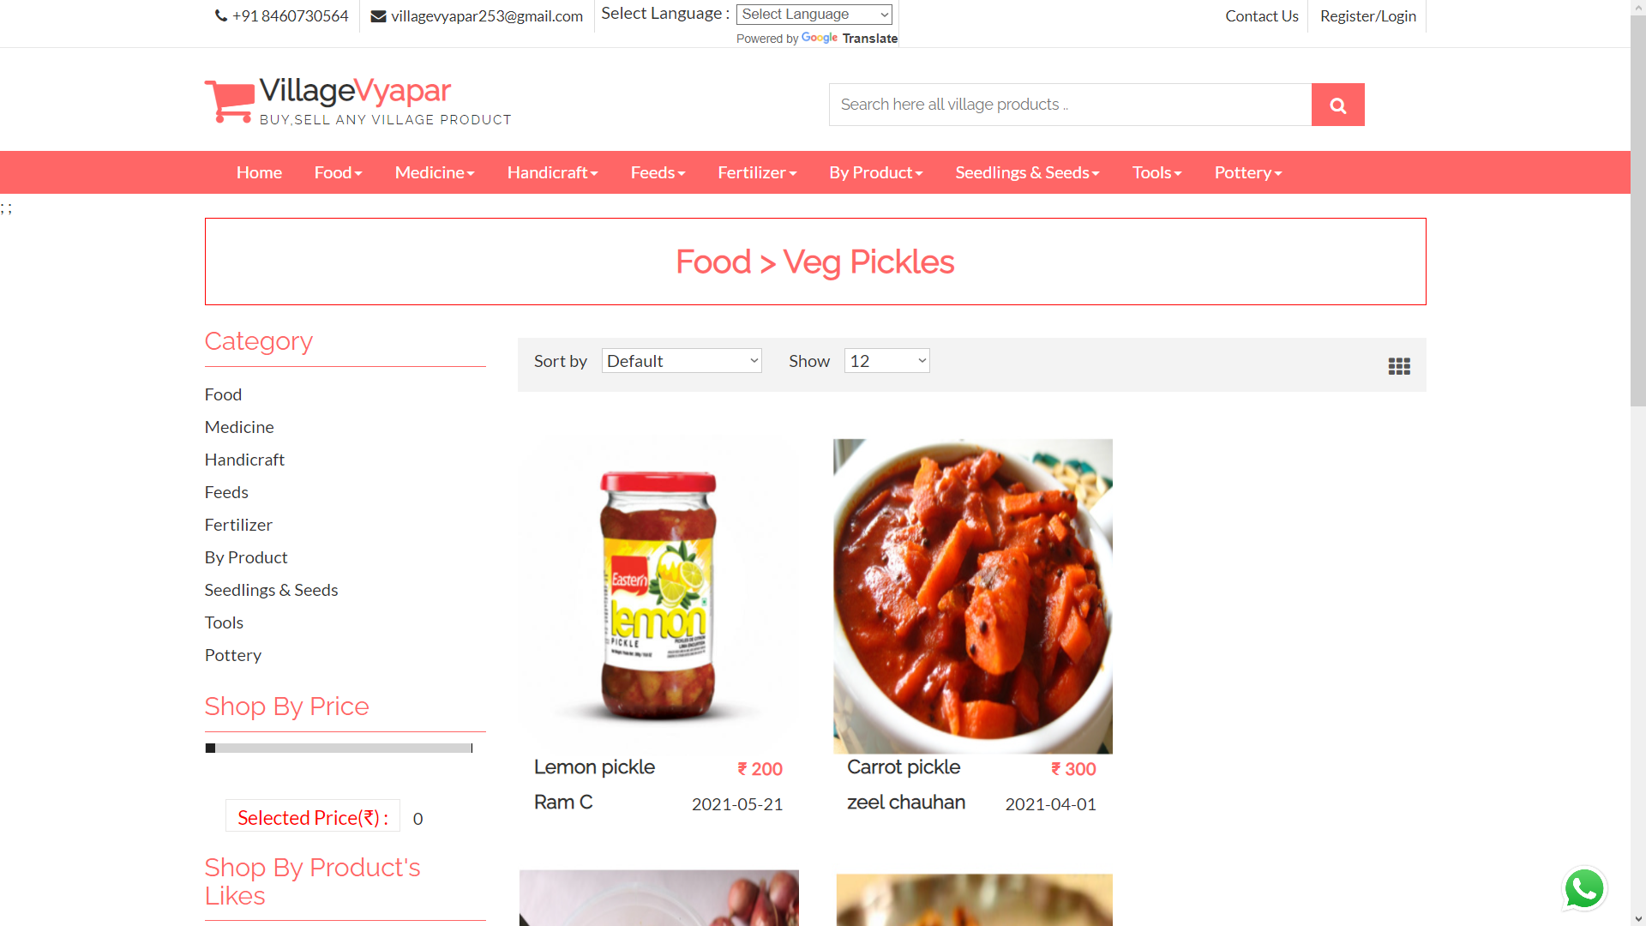
Products within subcategories

Slide 37
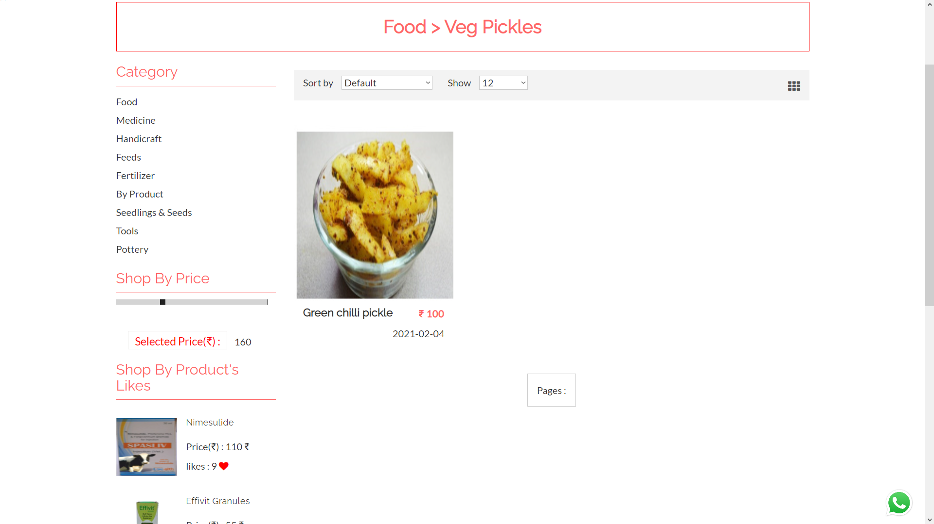
Products limited with price

Slide 38
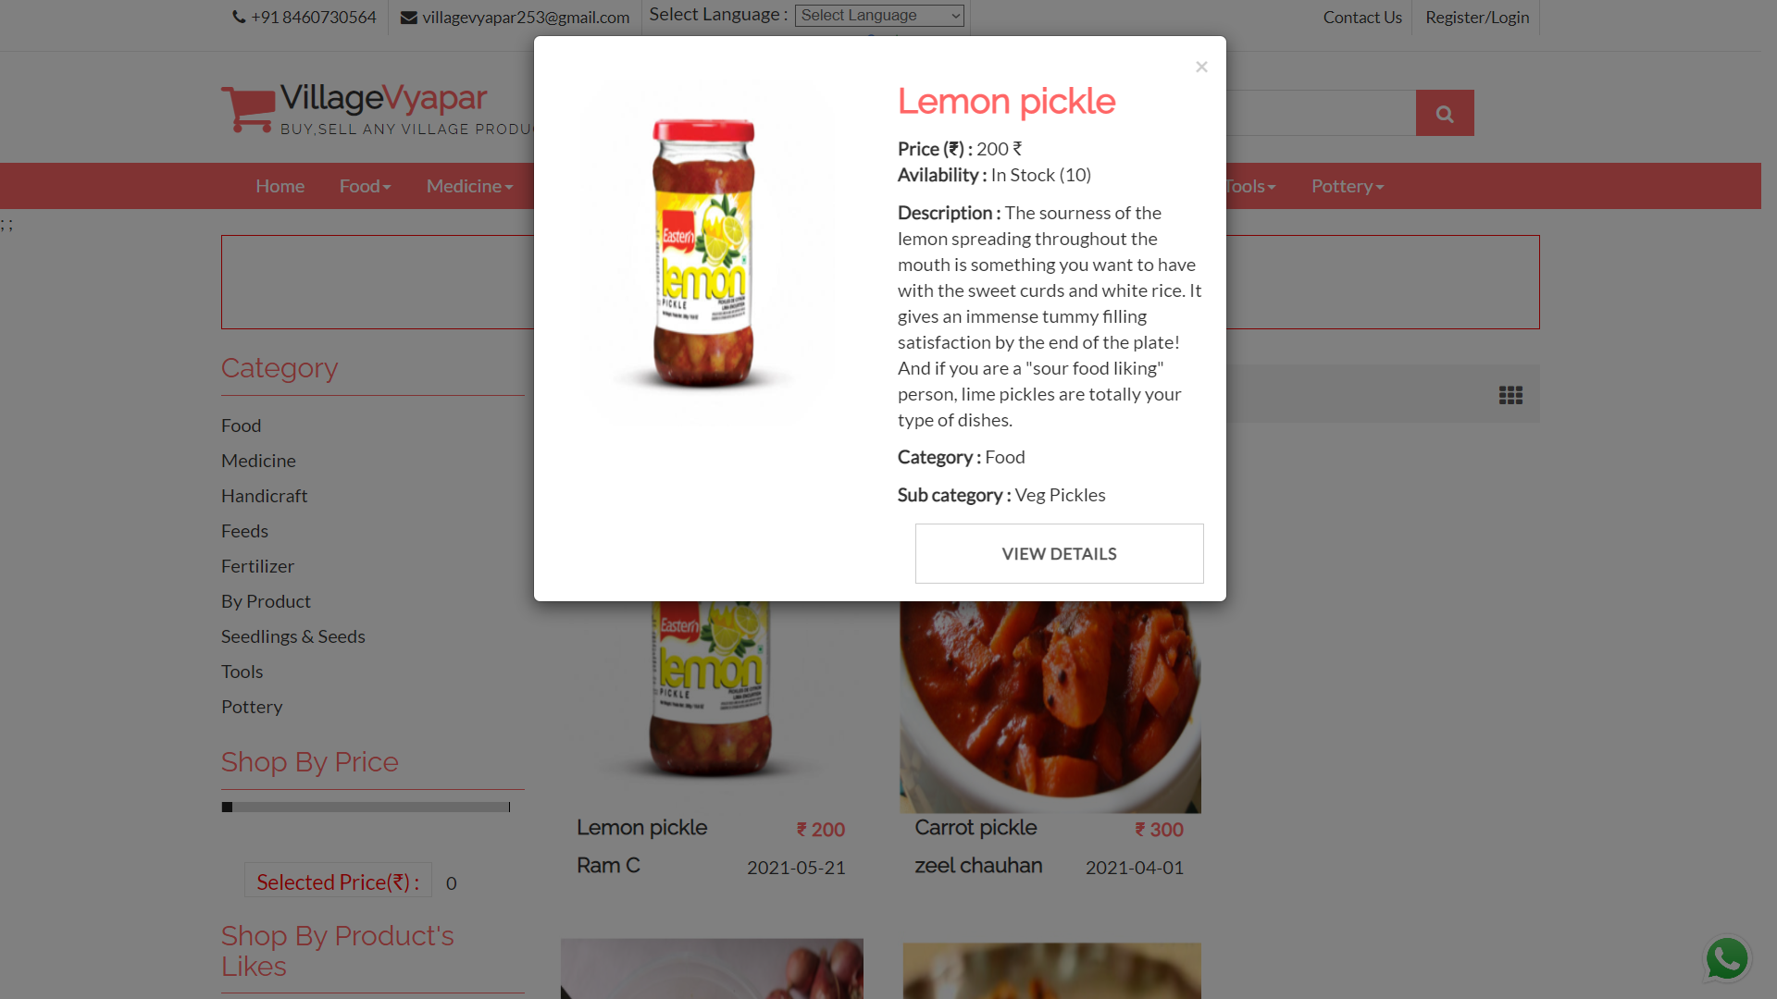
Product detail dialogue box

Slide 39
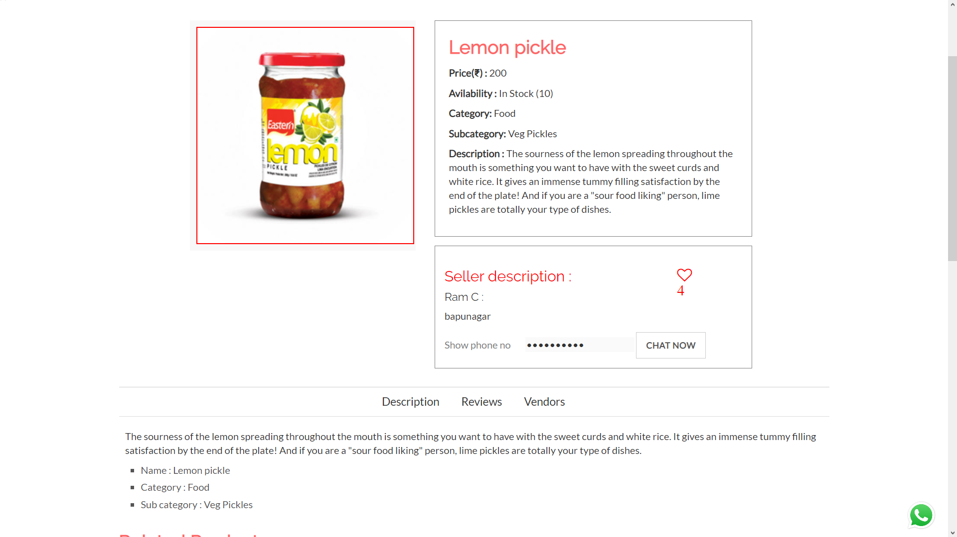
Product details

Slide 40
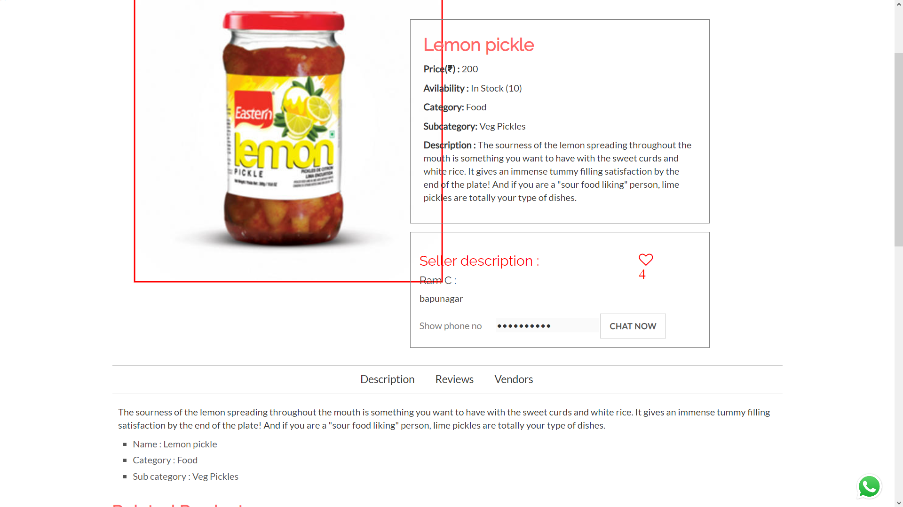
Product image zoomed

Slide 41
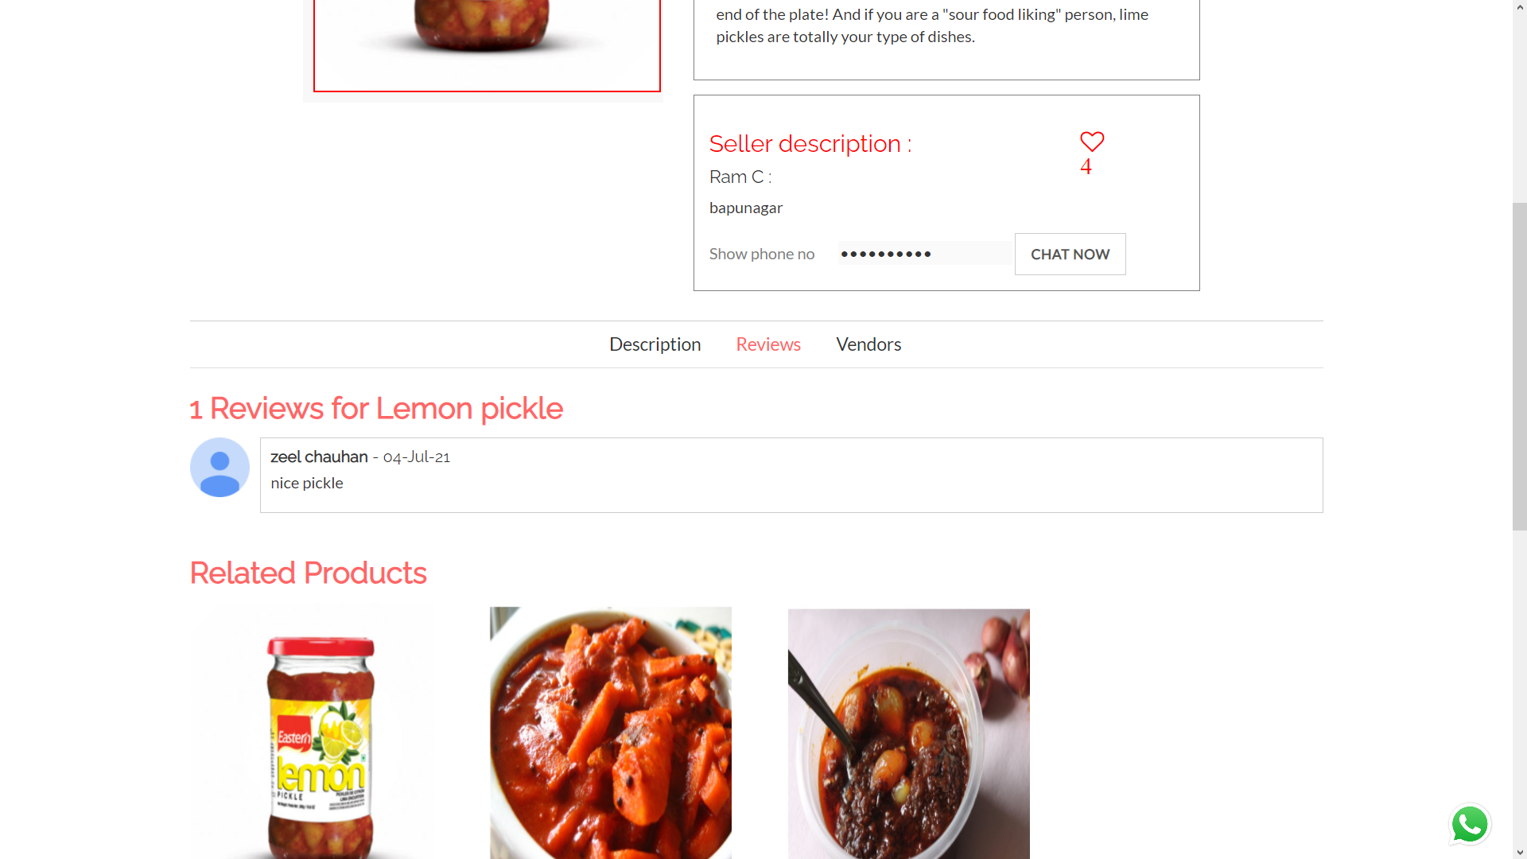
Product review

Slide 42
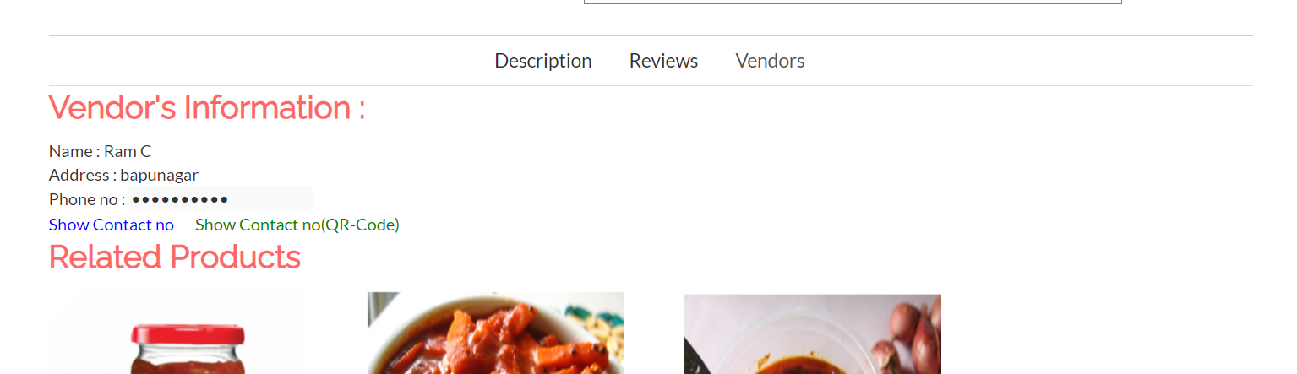
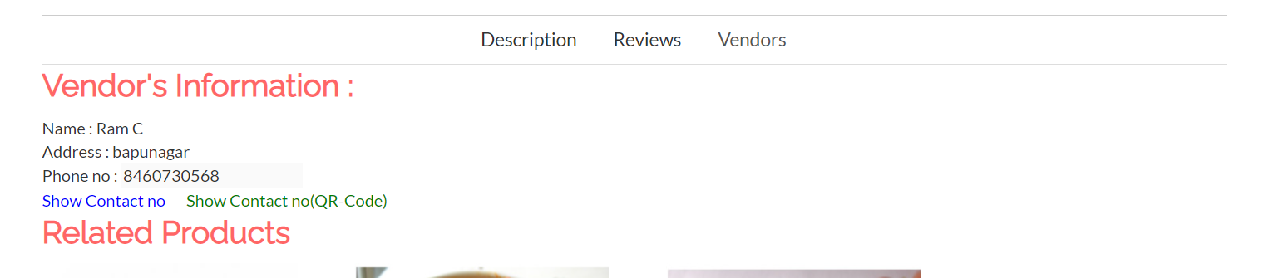
Vendor info 1

Slide 43
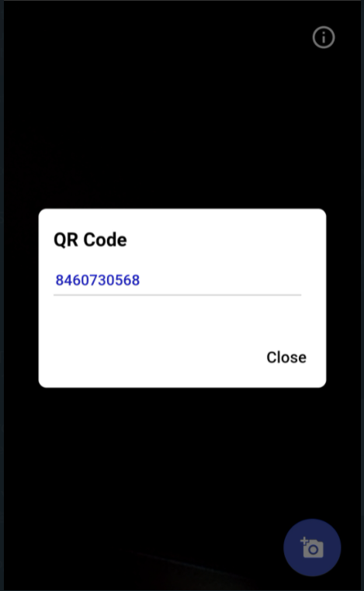
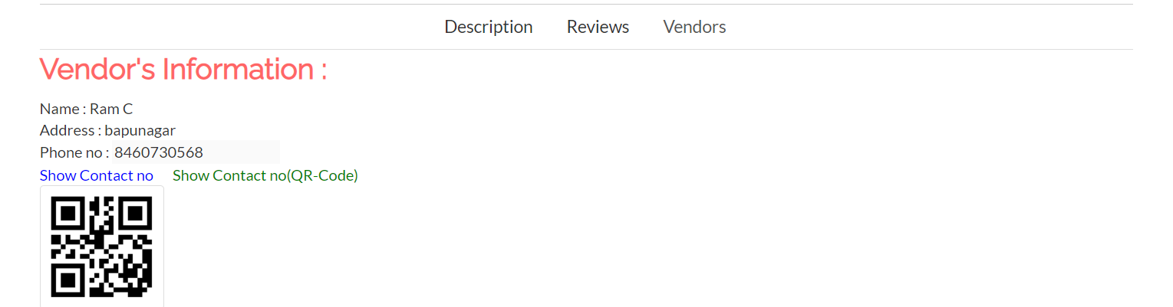
Vendor info 2

Slide 44
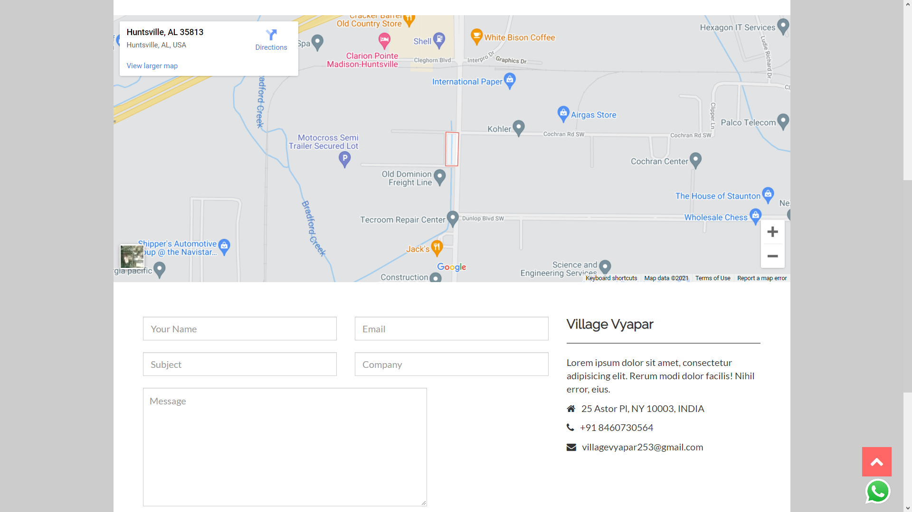
Contact us

Slide 45
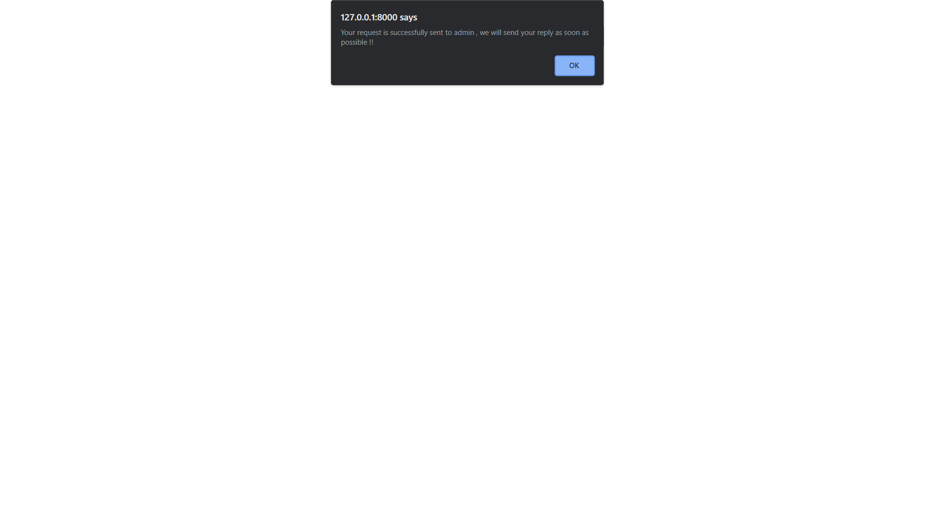
Inquiry asked

Slide 46
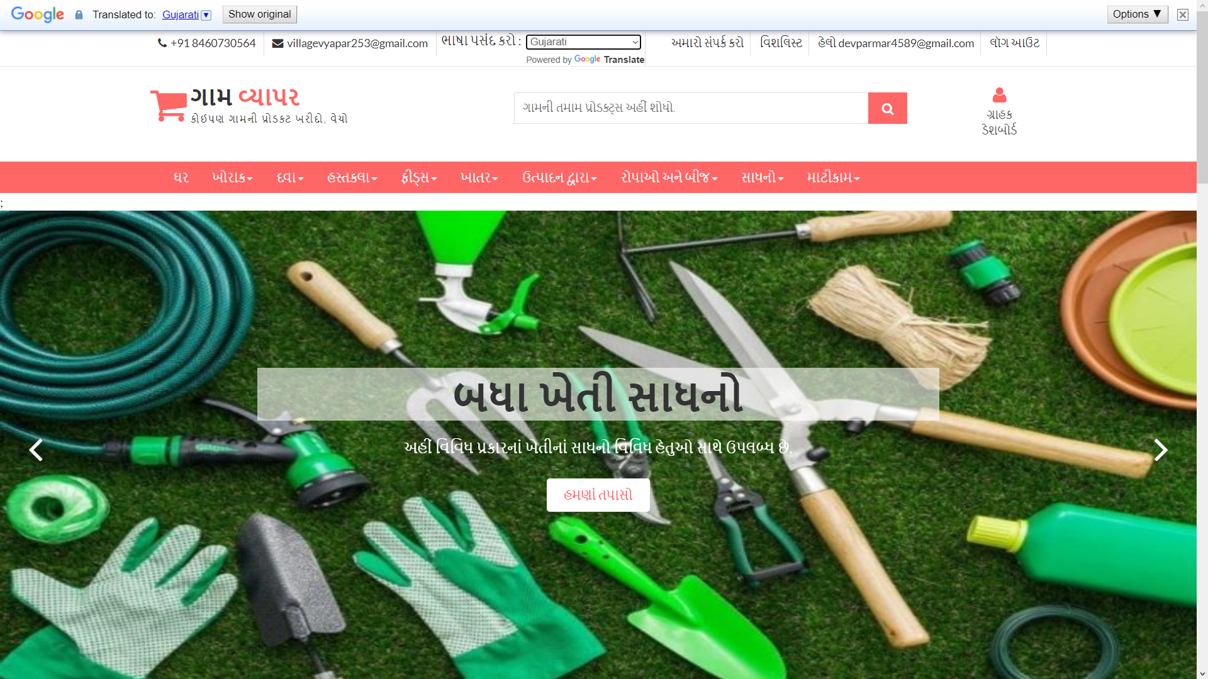
Language changes

Slide 47
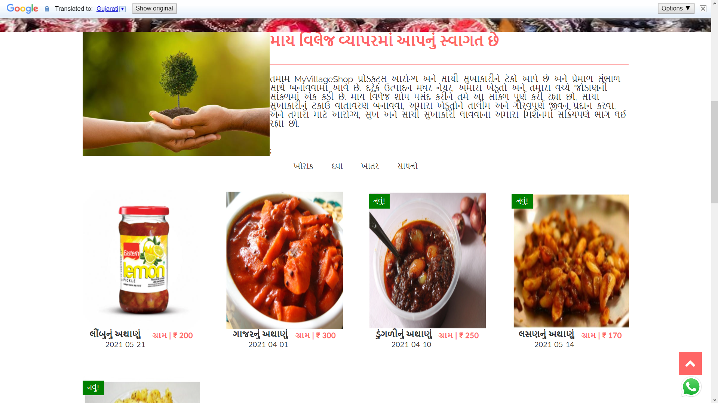
Language changes

Slide 48
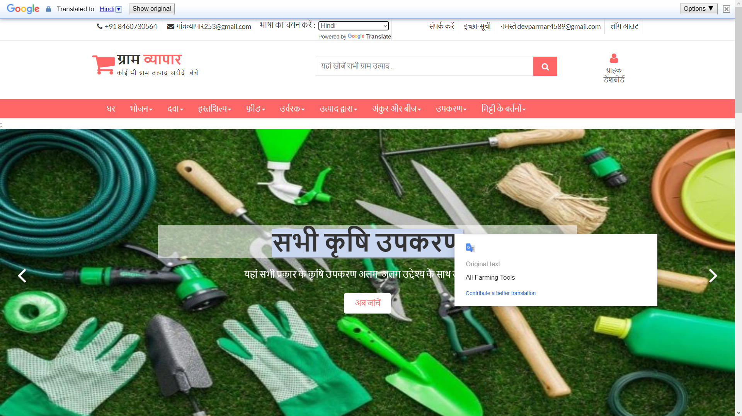
Language changes

Slide 49
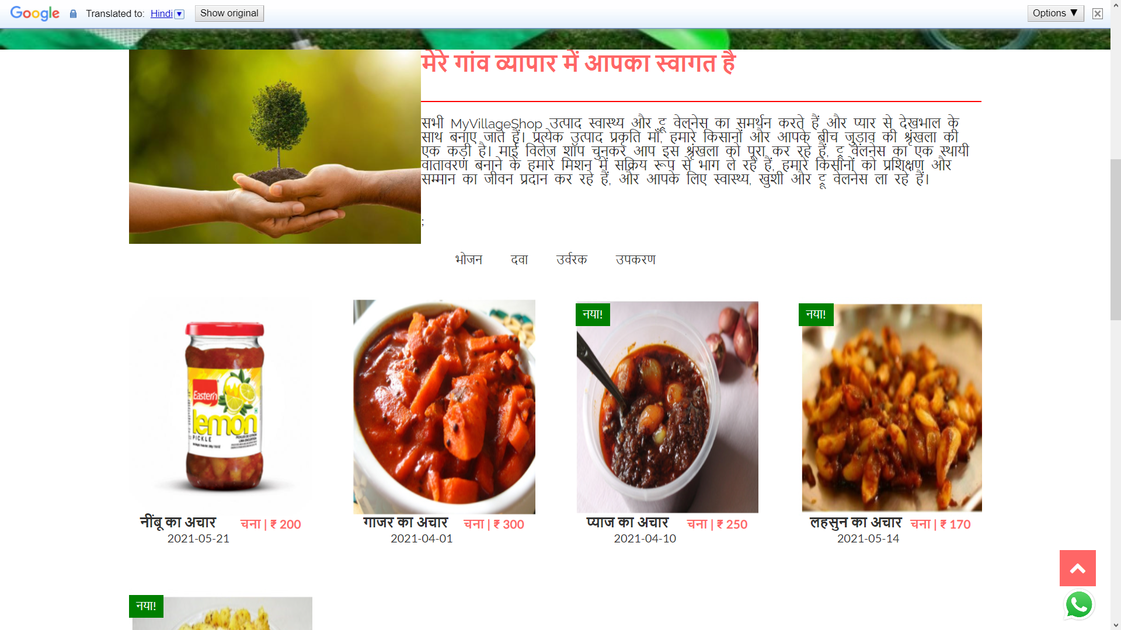
Language changes

Slide 50
Login

Slide 51
Targeted Users

Slide 52
3
Screen-shots (Admin)

Slide 53
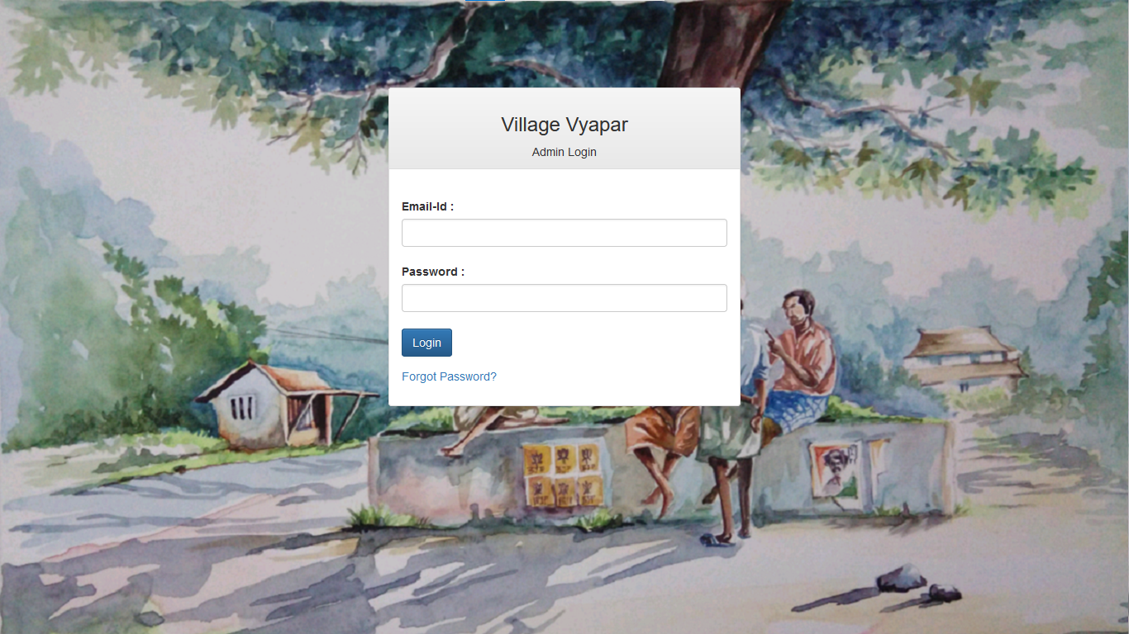
Admin-login Page

Slide 54
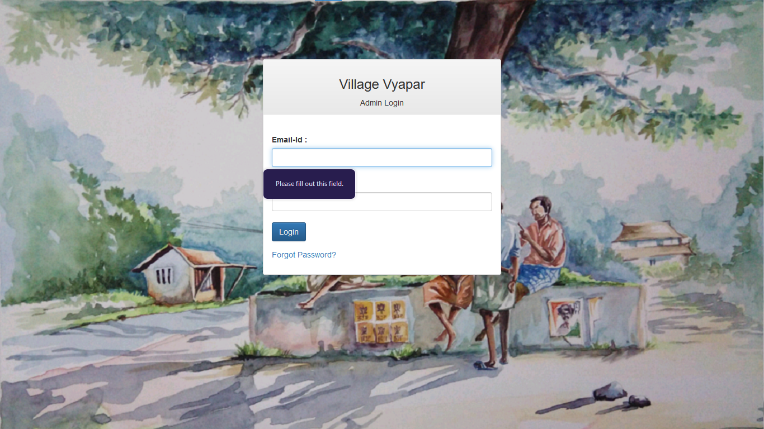
Validate Credential

Slide 55
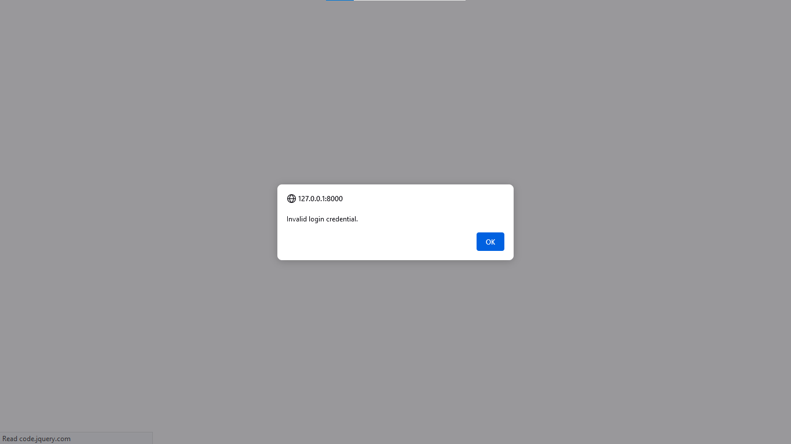
Invalid Login-credential

Slide 56
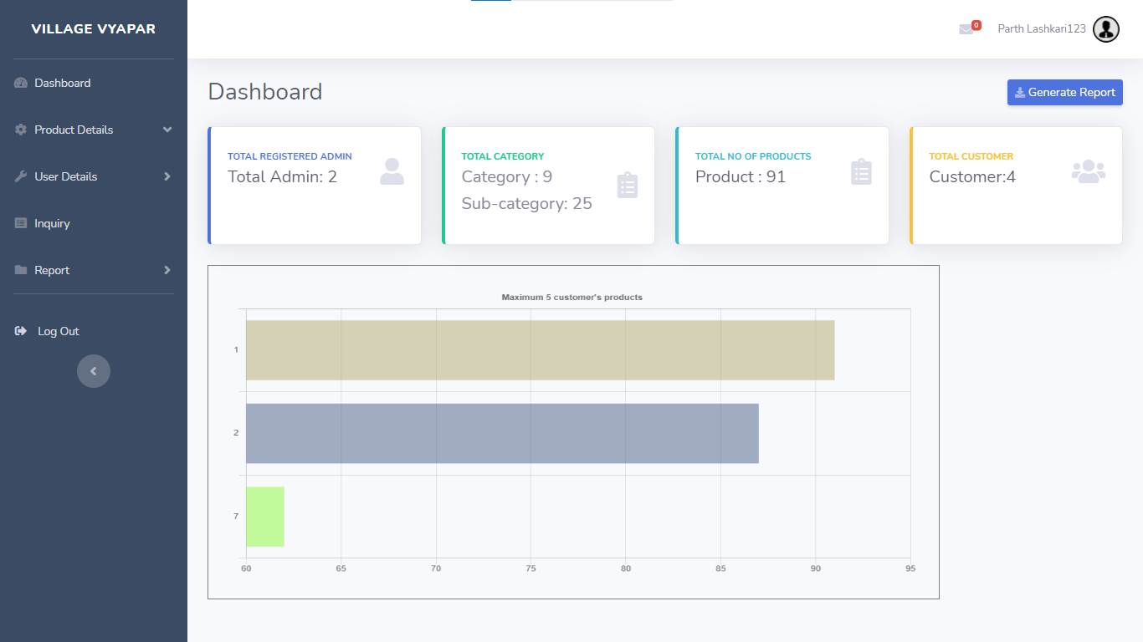
After Successful Login -Dashboard

Slide 57
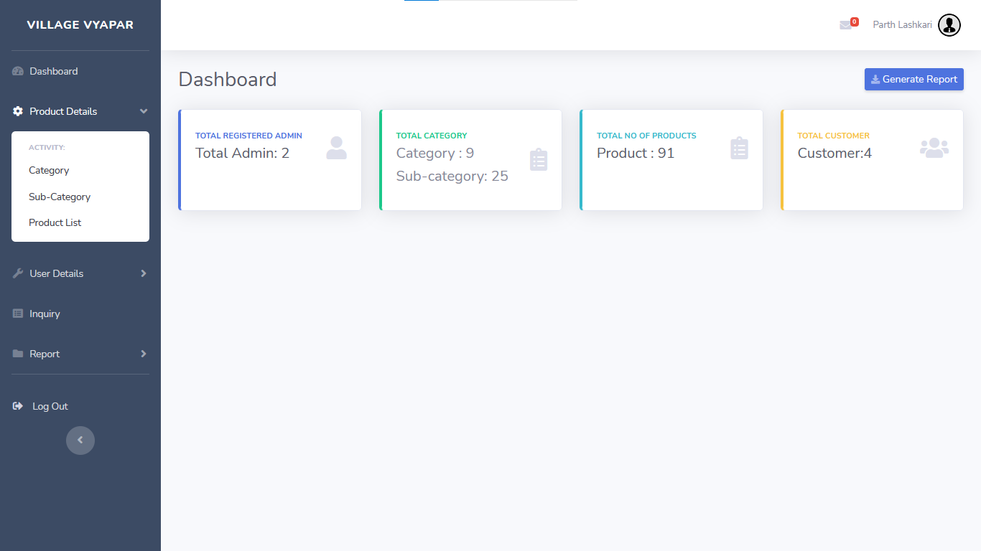
Show Product detail menu

Slide 58
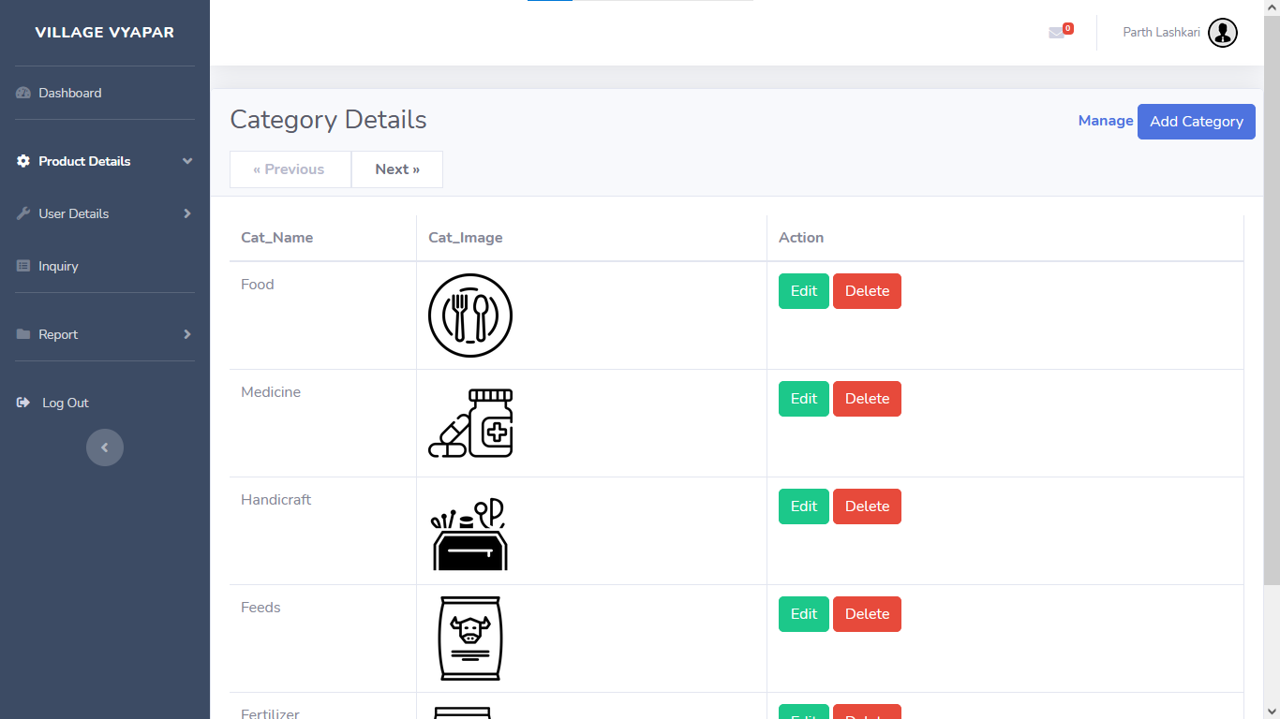
Show Categories

Slide 59
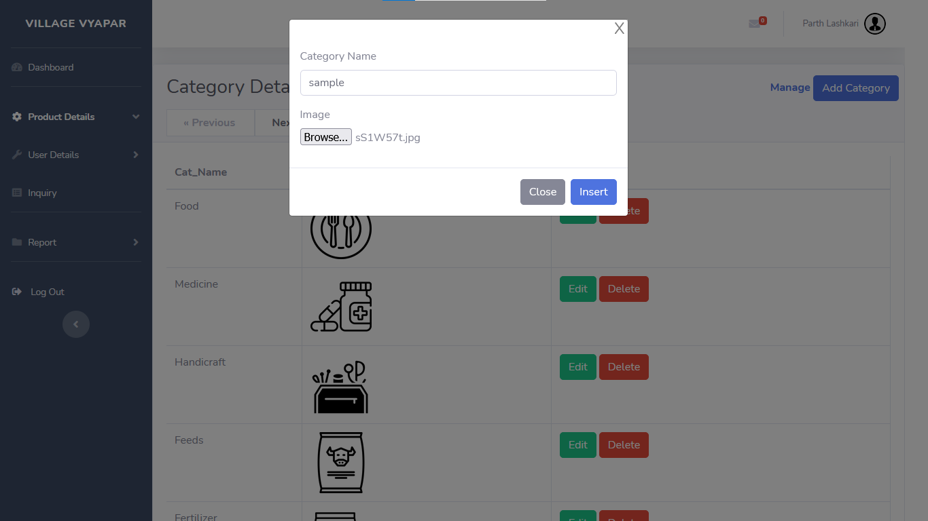
Add Category

Slide 60
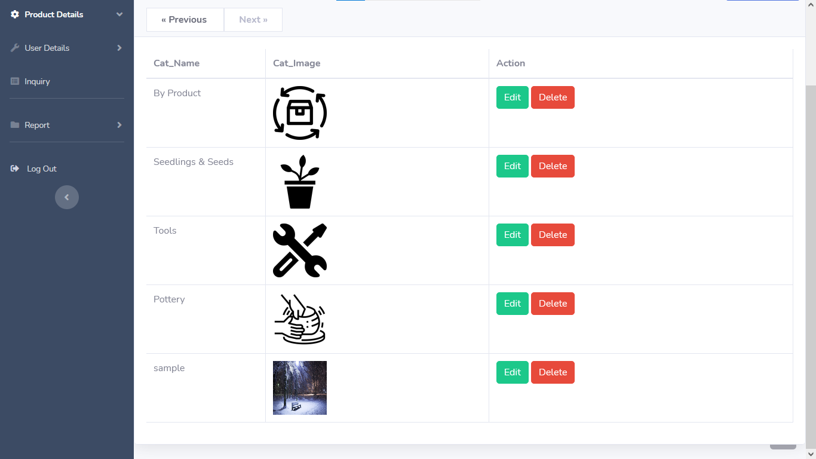
After Add New Category

Slide 61
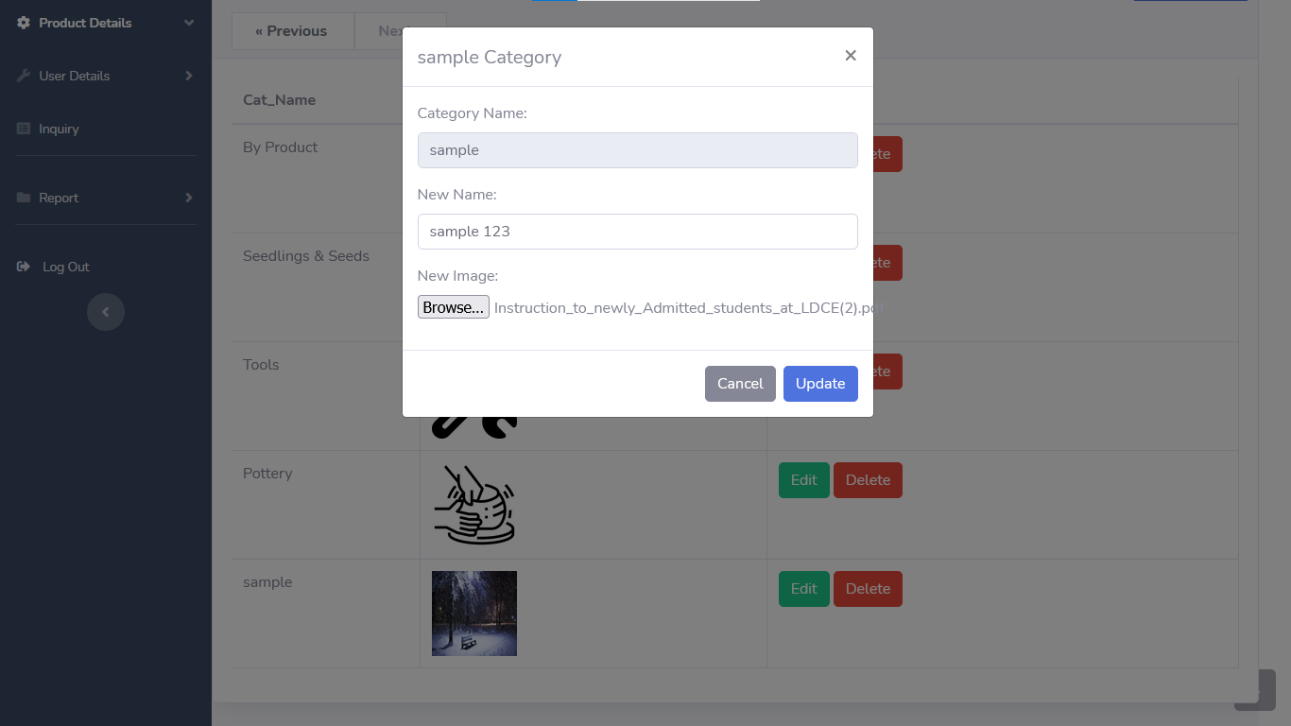
Edit Category

Slide 62
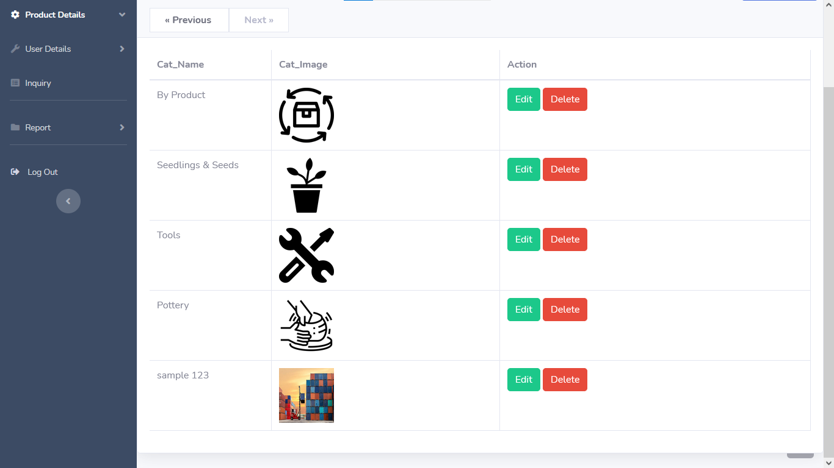
After Successfully Edit Category

Slide 63
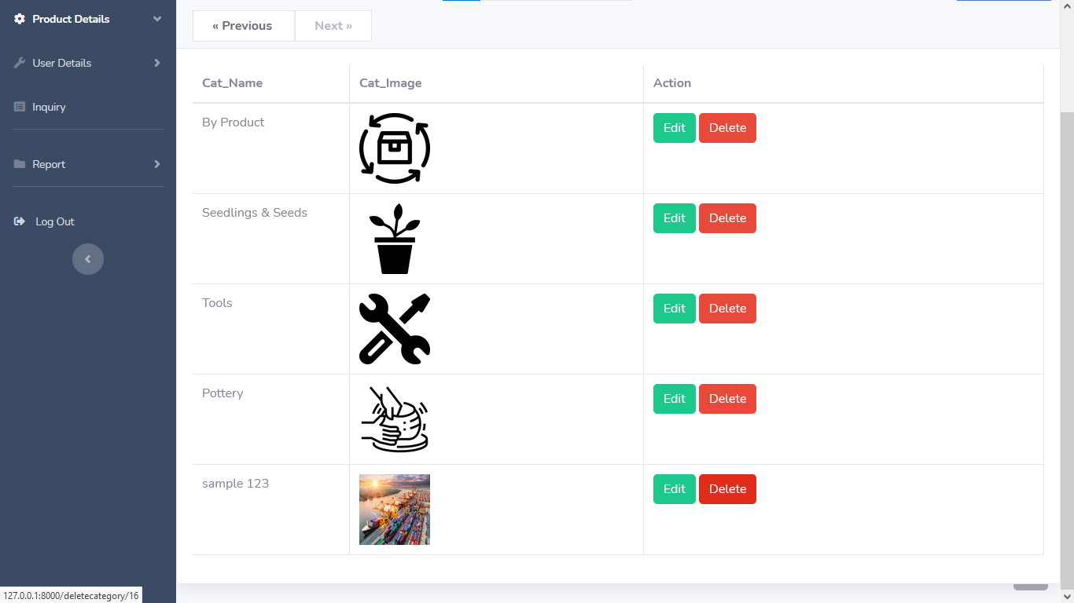
Delete Category

Slide 64
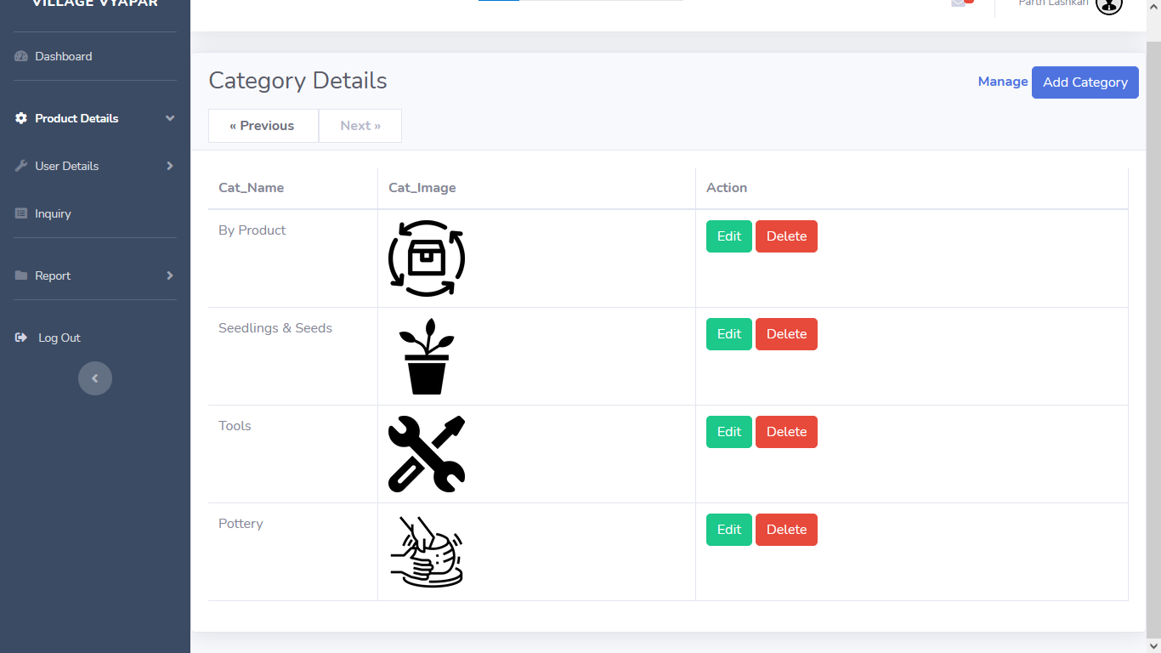
After Delete Sample Category

Slide 65
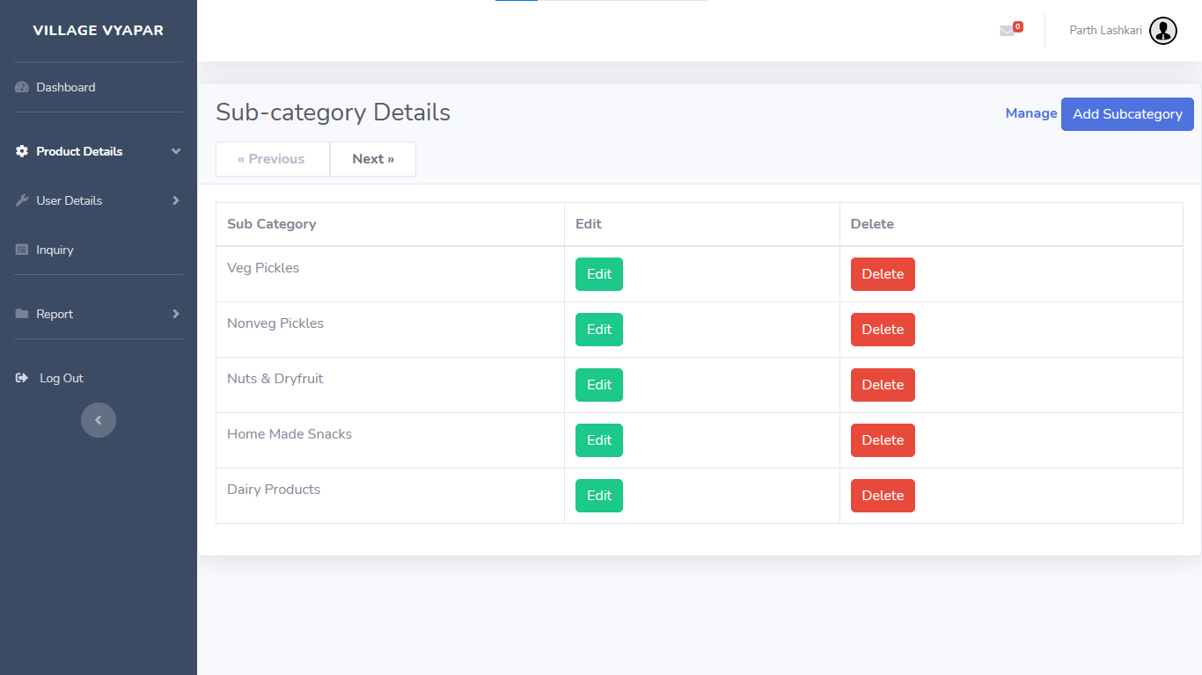
Show Sub-Category

Slide 66
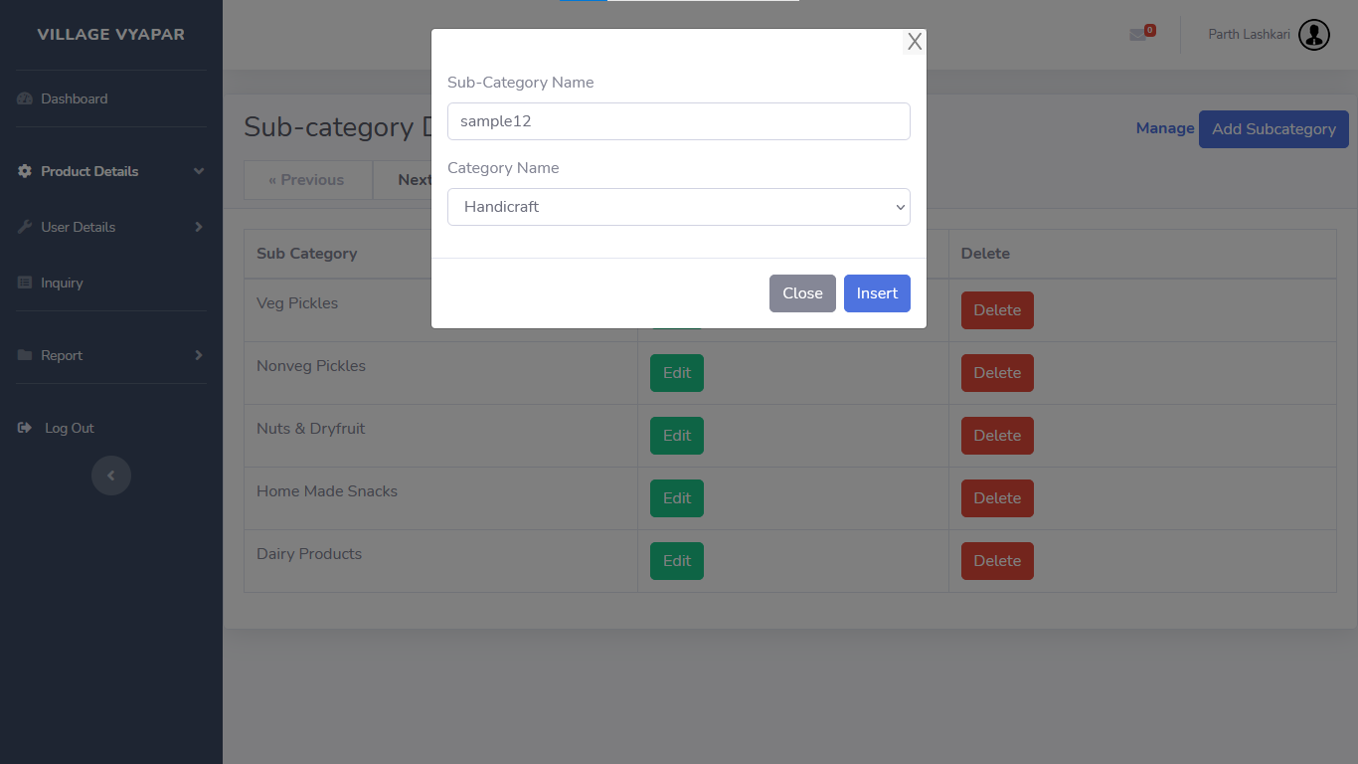
Add Sub-Category

Slide 67
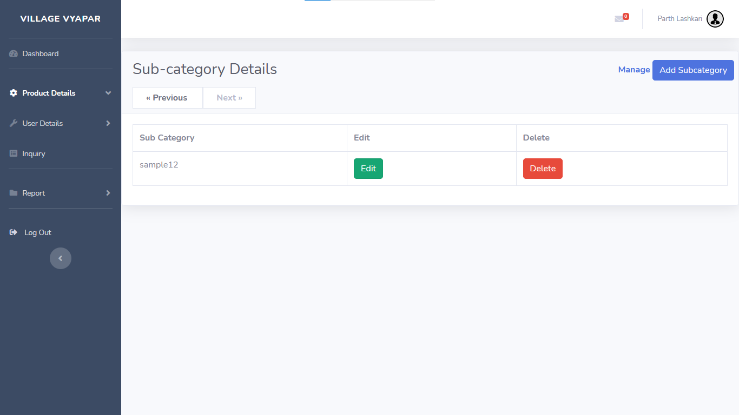
After Add New Sub-Category

Slide 68
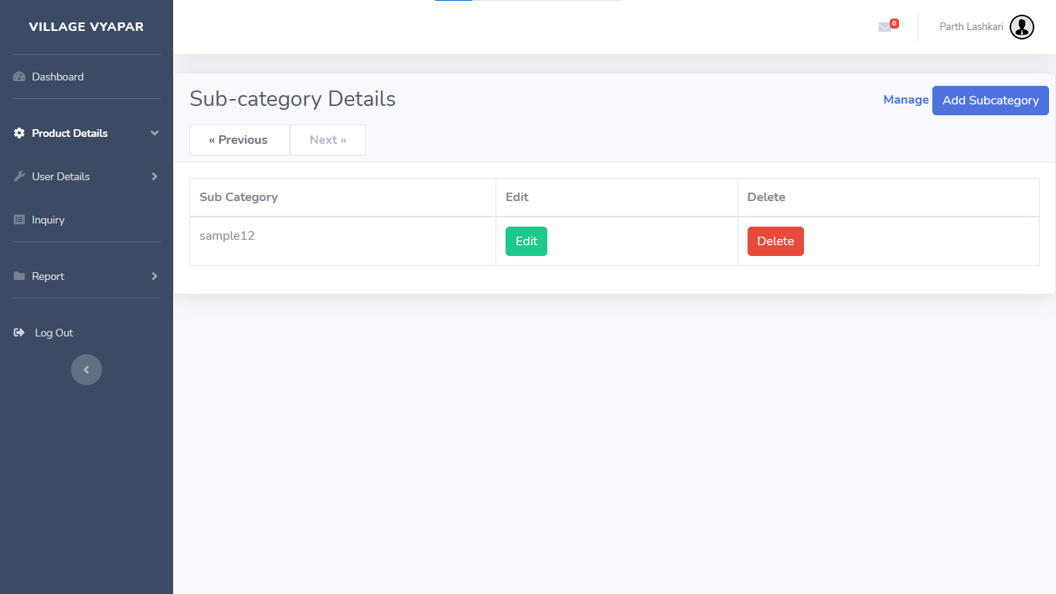
Delete Sub-Category

Slide 69

After Delete Sub-Category

Slide 70
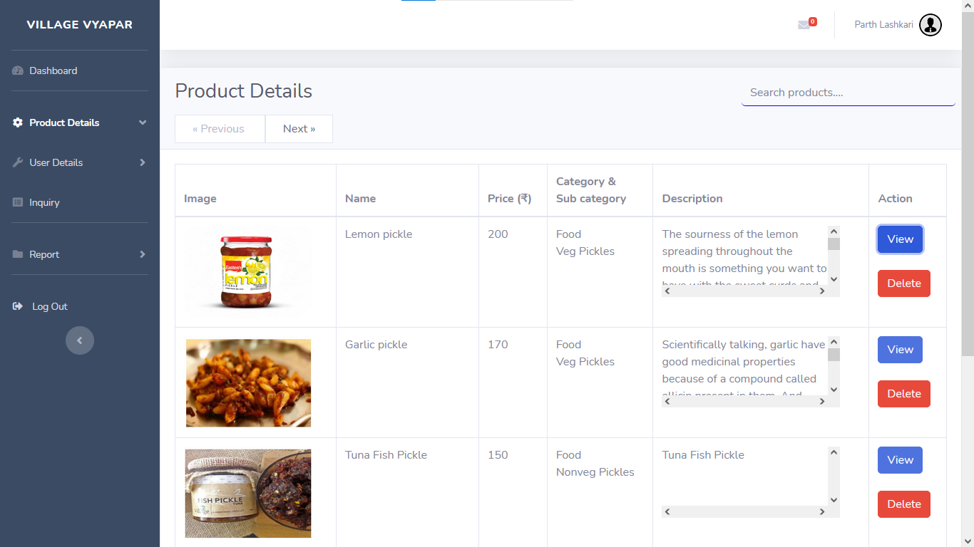
Shows Products

Slide 71
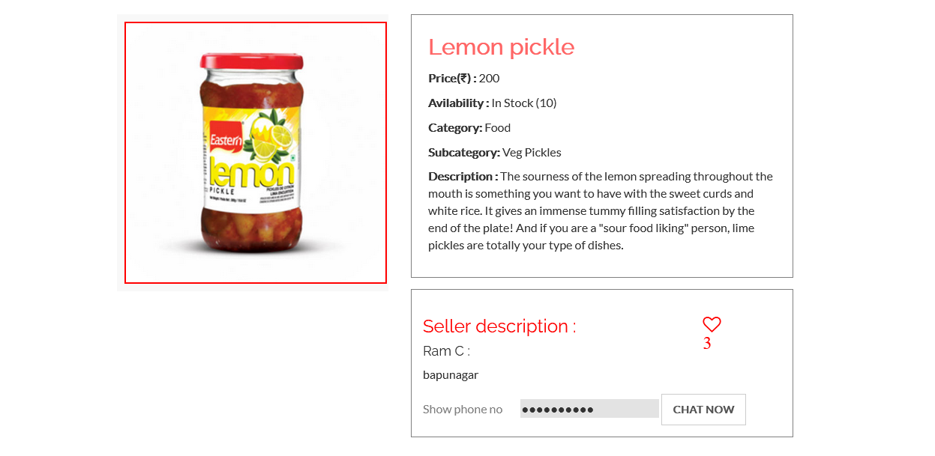
View Product

Slide 72
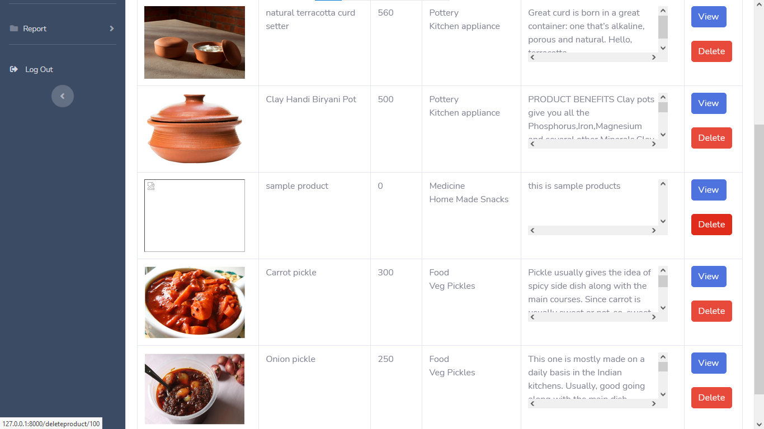
Delete Sample Product

Slide 73
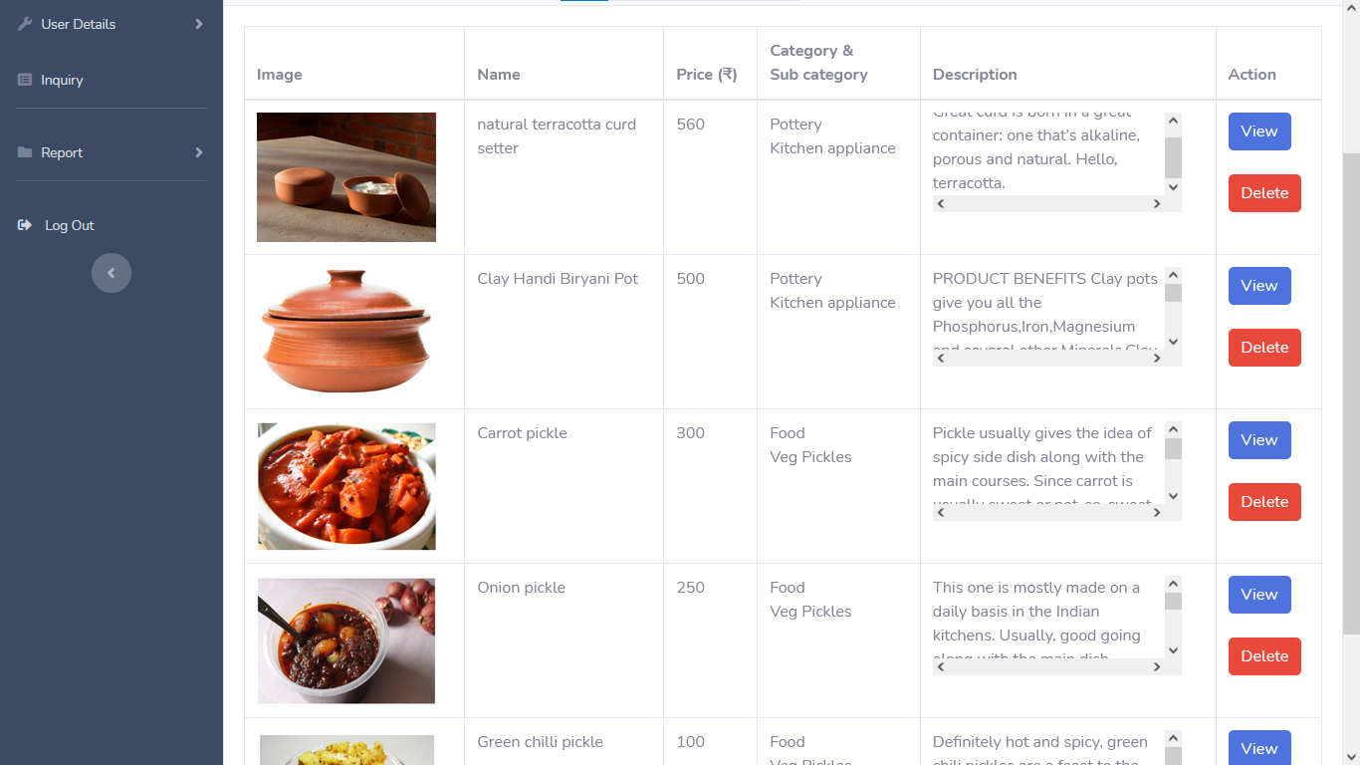
After Delete Sample Product

Slide 74
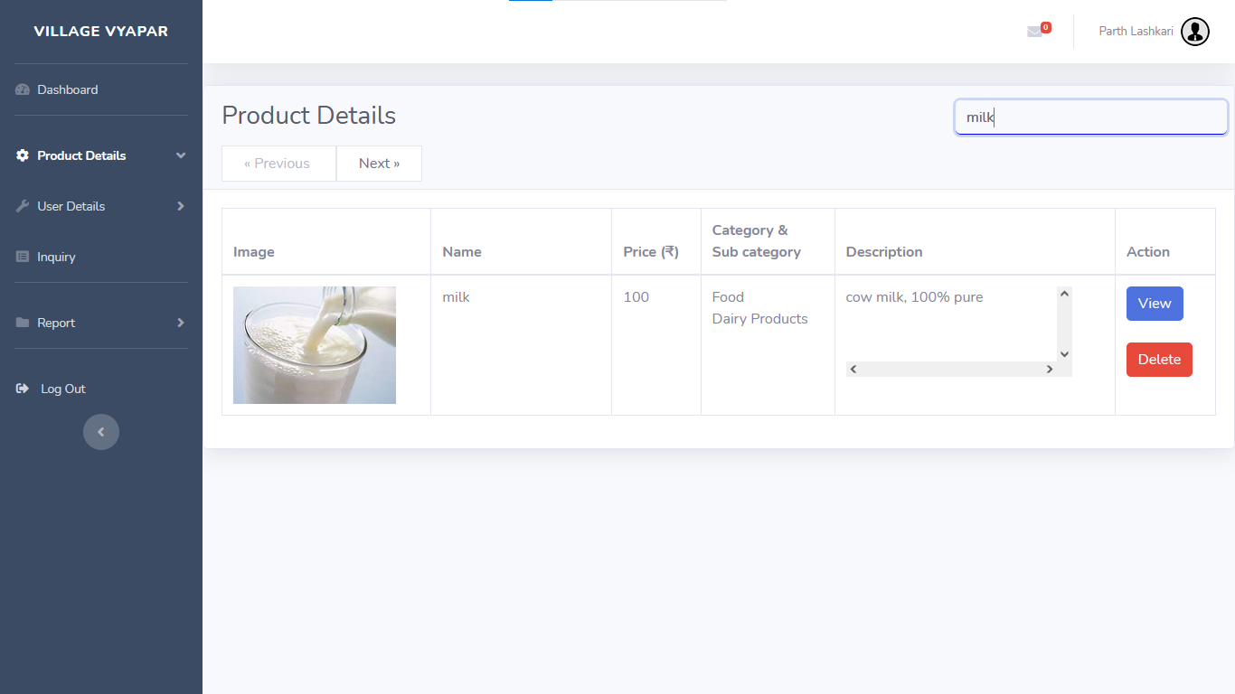
Search Product

Slide 75

Show User-details Menu

Slide 76

View customer list

Slide 77

Search Customer

Slide 78

View Admin list

Slide 79

Show Inquiry

Slide 80

Reply To An inquiry

Slide 81

After Reply To An inquiry

Slide 82

Show Admin Menu

Slide 83

Edit Admin profile

Slide 84

After Edit Admin Profile

Slide 85

Admin Forgot Password 1

Slide 86

Admin Forgot Password 2

Slide 87

Security Code on Mail

Slide 88

After entering security code and detail

Slide 89

Show Report Menu

Slide 90

Admin Logout

Slide 91
After Logout

Slide 92
3
System Design

Slide 93
Use Case Diagram

Slide 94
Class Diagram

Slide 95
Interaction Diagram

Slide 96
Activity Diagram

Slide 97
Data Dictionary

Slide 98
4
Development

Slide 99
5
Proposed Enhancement

Slide 100
6
Conclusion

Slide 101
7
Bibliography

Slide 102
CONTENTS
1
4
ADD THE SLIDE TITLE HERE
ADD THE SLIDE TITLE HERE
Please add a comment here
Please add a comment here
2
5
ADD THE SLIDE TITLE HERE
ADD THE SLIDE TITLE HERE
Please add a comment here
Please add a comment here
3
6
ADD THE SLIDE TITLE HERE
ADD THE SLIDE TITLE HERE
Please add a comment here
Please add a comment here

Slide 103
1
ADD THE SLIDE TITLE HERE
PLEASE ADD SLIDE SUBTITLE HERE

Slide 104



Please add title in here
ADD
KEY
WORDS
Please add text here, according to the need to adjust the font and font size. Please add text here, according to the need to adjust the font and font size.
Please add text here, according to the need to adjust the font and font size. Please add text here, according to the need to adjust the font and font size.
Please add text here, according to the need to adjust the font and font size.
ADD
KEY
WORDS
ADD
KEY
WORDS
Please add title in here
Please add text here, according to the need to adjust the font and font size.

Slide 105
Please add title in here
Please add text here, according to the need to adjust the font and font size. Please add text here.
Please add text here, according to the need to adjust the font and font size. Please add text here, according to the need to adjust the font and font size.
1 ADD KEY WORDS
Please add text here, according to the need to adjust the font and font size. Please add text here.
2 ADD KEY WORDS
Please add text here, according to the need to adjust the font and font size. Please add text here.
3 ADD KEY WORDS
Please add text here, according to the need to adjust the font and font size. Please add text here.
4 ADD KEY WORDS
Please add text here, according to the need to adjust the font and font size. Please add text here.
5 ADD KEY WORDS

Slide 106

Please add title in here
Please add text here, according to the need to adjust the font and font size. Please add text here, according to the need to adjust the font and font size.
Please add text here, according to the need to adjust the font and font size. Please add text here, according to the need to adjust the font and font size.
Please add title in here
Please add text here, according to the need to adjust the font and font size. Please add text here.

Slide 107
Please add text here, according to the need to adjust the font and font size, recommended justified form.
64%
50%
75%
ADD KEY WORDS
ADD KEY WORDS
ADD KEY WORDS
Please add text here, according to the need to adjust the font and font size.
Please add text here, according to the need to adjust the font and font size.
Please add text here, according to the need to adjust the font and font size.

Slide 108
ADD KEY WORDS
ADD KEY WORDS
Please add text here, according to the need to adjust the font and font size. Please add text here, according to the need to adjust the font and font size.
Please add text here, according to the need to adjust the font and font size. Please add text here, according to the need to adjust the font and font size.
Please add text here, according to the need to adjust the font and font size. Please add text here, according to the need to adjust the font and font size.
ADD KEY WORDS
Please add text here, according to the need to adjust the font and font size, recommended justified form. Please add text here, according to the need to adjust the font and font size.

Slide 109
10
Please add text here, according to the need to adjust the font and font size.
09
08
07
06
05
04
03
02
01
01
02
03
04
05
06
07
08
09
10
11
12
Please add text here, according to the need to adjust the font and font size, recommended justified form.

Slide 110
ADD KEY WORDS
ADD KEY WORDS
ADD KEY WORDS
Please add text here, according to the need to adjust the font and font size. Please add text here, according to the need to adjust the font and font size.
Please add text here, according to the need to adjust the font and font size. Please add text here, according to the need to adjust the font and font size.
Please add text here, according to the need to adjust the font and font size. Please add text here, according to the need to adjust the font and font size.
Please add text here, according to the need to adjust the font and font size. Please add text here, according to the need to adjust the font and font size.

Slide 111


Please add text here, according to the need to adjust the font and font size. Please add text here, according to the need to adjust the font and font size.
Please add text here, according to the need to adjust the font and font size. Please add text here, according to the need to adjust the font and font size.
Please add text here, according to the need to adjust the font and font size. Please add text here, according to the need to adjust the font and font size. Please add text here, according to the need to adjust the font and font size. Please add text here, according to the need to adjust the font and font size.

Slide 112
Please add title in here
Please add text here, according to the need to adjust the font and font size.
000T
000T
000T
000T
000T
000T
000T
000T
000T
000T
000T
000T
01
02
03
04
05
06
07
08
09
10
11
12
Please add text here, according to the need to adjust the font and font size. Please add text here, according to the need to adjust the font and font size.

Slide 113
Please add text here, according to the need to adjust the font and font size.
Please add text here, according to the need to adjust the font and font size.
ADD KEY WORDS
ADD KEY WORDS
ADD KEY WORDS
ADD KEY WORDS
Please add text here, according to the need to adjust the font and font size.
Please add text here, according to the need to adjust the font and font size.
Please add text here, according to the need to adjust the font and font size. Please add text here, according to the need to adjust the font and font size. Please add text here, according to the need to adjust the font and font size. Please add text here.

Slide 114
3
ADD THE SLIDE TITLE HERE
PLEASE ADD SLIDE SUBTITLE HERE

Slide 115
Please add text here, according to the need to adjust the font and font size.
ADD KEY WORDS
Please add text here, according to the need to adjust the font and font size. Please add text here, according to the need to adjust the font and font size.
Please add text here, according to the need to adjust the font and font size. Please add text here, according to the need to adjust the font and font size.
ADD
KEY WORDS
ADD KEY WORDS
ADD KEY WORDS
ADD KEY WORDS
Please add text here, according to the need to adjust the font and font size.
Please add text here, according to the need to adjust the font and font size. Please add text here, according to the need to adjust the font and font size. Please add text here, according to the need to adjust the font and font size.

Slide 116



Please add text here, according to the need to adjust the font and font size. Please add text here, according to the need to adjust the font and font size.
5 ADD KEY WORDS
5 ADD KEY WORDS
5 ADD KEY WORDS
Please add text here, according to the need to adjust the font and font size. Please add text here, according to the need to adjust the font and font size.
Please add text here, according to the need to adjust the font and font size. Please add text here, according to the need to adjust the font and font size.
Please add text here, according to the need to adjust the font and font size. Please add text here, according to the need to adjust the font and font size.

Slide 117

Please add title in here
Please add title in here
Please add text here, according to the need to adjust the font and font size.
Please add title in here
Please add text here, according to the need to adjust the font and font size.
Please add title in here
Please add text here, according to the need to adjust the font and font size.

Slide 118
Please add text here, according to the need to adjust the font and font size. Please add text here, according to the need to adjust the font and font size.
Please add text here, according to the need to adjust the font and font size. Please add text here, according to the need to adjust the font and font size.
Please add text here, according to the need to adjust the font and font size. Please add text here, according to the need to adjust the font and font size.
ADD KEY WORDS
ADD KEY WORDS
ADD KEY WORDS
Please add text here, according to the need to adjust the font and font size. Please add text here, according to the need to adjust the font and font size.

Slide 119
Please add title in here
Please add title in here
Please add text here, according to the need to adjust the font and font size. Please add text here, according to the need to adjust the font and font size.
Please add text here, according to the need to adjust the font and font size. Please add text here, according to the need to adjust the font and font size.
Please add text here, according to the need to adjust the font and font size. Please add text here, according to the need to adjust the font and font size.
Please add text here, according to the need to adjust the font and font size. Please add text here, according to the need to adjust the font and font size.
Please add text here, according to the need to adjust the font and font size. Please add text here, according to the need to adjust the font and font size. Please add text here, according to the need to adjust the font and font size.

Slide 120
THANK YOU
Group No : 04

